Slide 1
The Impact of COVID-19 in Tribal Communities

Slide 2
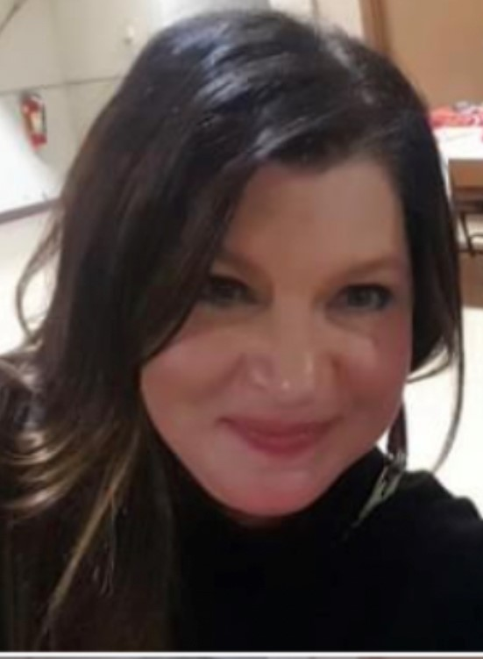
Today’s Presenters:
Mark Ford
Director of Community Partnerships & Tribal Relations
Partnership with Native Americans
mford@nativepartnership.org
602-340-8050 Ext. 304
www.nativepartnership.org
Chele Rider
Division Disaster State Relations Director Tribal Relations
American Red Cross
Chele.Rider@redcross.org
202-230-3978
www.redcross.org

Slide 3
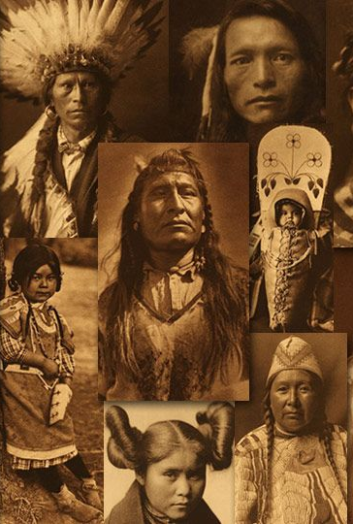
Who Are We?
What are we called?
American Indians? Native Americans? First Americans? First Nations? Indigenous? Alaska Natives, Native Hawaiians?
Where do we live?
Reservations, Tribal communities, Rancherias, Missions, Pueblos, Villages, Urban/Rural
How do we identify with our culture/traditions/heritage?
Traditional - Bi-Cultural - Integrated
Notes:
Chele

Slide 4
USA Native Population (2010 census)
Total American Indian/Alaska Native (AI/AN) alone population: 2.9 million or about 0.9 percent of the US population.
Total AI/AN population alone or in combination with other races: 5.2 million or 1.7 percent of the US population.
States with the highest proportion of American Indians and Alaska Natives: Alaska (19.5%), Oklahoma (12.9%), New Mexico (10.7%).
71% of American Indian/Alaska Natives live in urban settings – a large percentage of Urban Indians are migratory (returning to tribal community and then back to the urban environment)
Notes:
Mark

Slide 5
Tribes in USA
574 Federally Recognized
63+ State Recognized
+ 250 Bands
and other configurations
326 Reservations
Some tribes were not given a reservation (allotted federal land)
Some tribes share a reservation
Some tribes have more than one reservation
Notes:
Chele

Slide 6
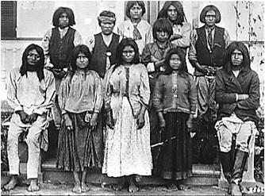
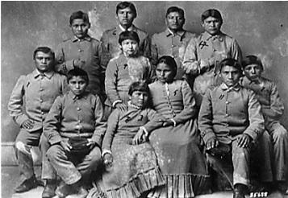
USA Native Policy Eras
Colonization
(1492 – 1828) ​
Spanish French English Russian
United States formed in 1776​
Removal, Reservation, and Treaty Era (1828-1887)
Westward Expansion, tribes forced out of homlands, disease
Trail of Tears /Long Walk
Reservations are prison camps
Allotment & Assimilation Era (1887-1934) Reservations ​
Shift from military oppression to cultural oppression Indian
1st attempt to force tribes to assimilate (Boarding schools/land removal
Reorganization/ Termination/Relocation Era (1934-1968)
Next attempt to assimilate tribes by moving them to urban centers
Reduction of number of federally recognized tribes ​ ​
Native Americans at an Indian School
Photo courtesy of Arizona Historical Foundation
Self-Determination Era
(1968 – Present) ​
Self-governance and all federal agencies must support tribal programs
Testing Tribal Sovereignty
Notes:
Chele

Slide 7
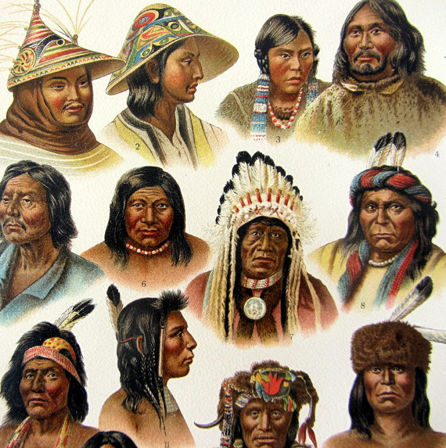
Historical Facts about Native Americans in the USA
Native Americans didn’t become US Citizens until 1924 with the Indian Citizenship Act. This also gave permission for Native Americans to travel freely anywhere in the USA.
Native Americans weren’t allowed to vote in all 50 states until 1962.
From 1870 to 1934 Native Americans were banned from practicing any traditional religious or spiritual ceremonies.
Before colonization, the estimated population was 18M Native Americans. The number recorded of Native Americans fell to 228,000 in 1890.
Before colonization over 300 languages were spoken. Today there are 154 languages.
Notes:
Chele

Slide 8
Impact of COVID-19 on Tribes

Slide 9
Statistics
1 in 475 Native Americans were infected compared to
1 in 825 of Caucasians
Per 100,000 people:
Native Americans have had 211 deaths
Caucasian Americans have had 121 deaths
Latino Americans, 120 deaths
Pacific Islander Americans, 150 deaths
Black Americans, 155 deaths
Asian Americans, 76 deaths

Slide 10
Statistics
Actual death counts are probably higher because some states and cities don’t collect death data on Native Americans. States with hard-hit Native populations include Mississippi, New Mexico, Arizona, Wyoming, Montana, North Dakota, and South Dakota.
“Losing 1% of our people is the equivalent of losing 3 million Americans. Native Americans are used to dying at disproportionate rates and we’re used to scarcity but Covid is different, there’s a growing sense of hopelessness.”
In June 2020, the Navajo Nation reported around 6,000 coronavirus cases and an infection rate of 3.4% -- the highest in the country. New York state, by comparison, had a 1.9% infection rate.
Loss of Elders and Wisdom Keepers
WebMD: https://www.webmd.com/lung/news/20210204/covid-deadlier-for-native-americans-than-other-groups

Slide 11
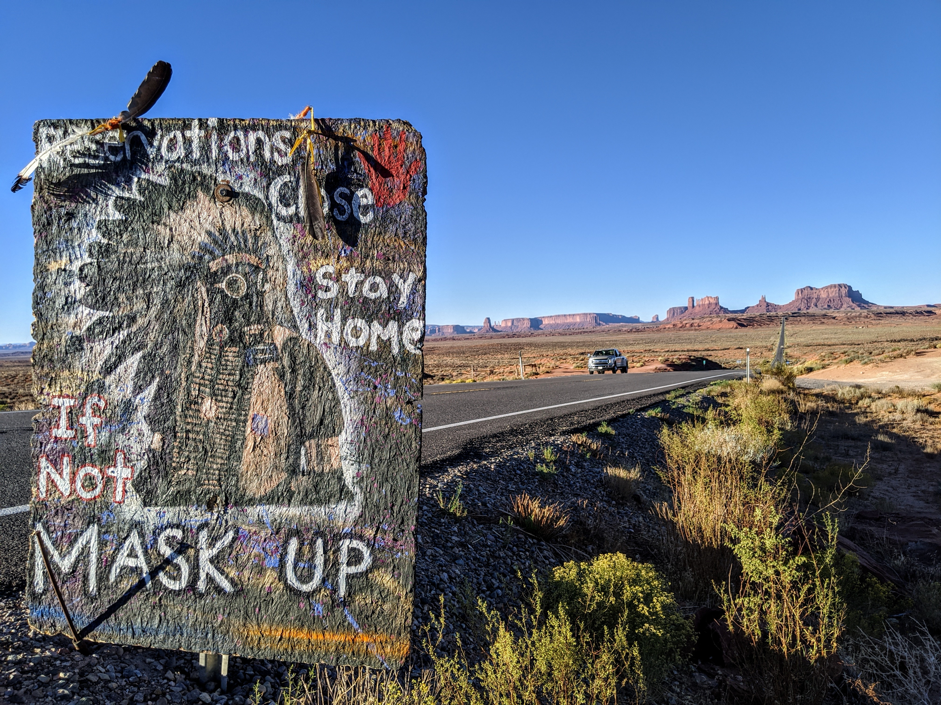
Factors that made more Tribes more vulnerable to COVID-19
Pre-existing health issues (diabetes, heart issues, obesity, malnutrition, etc.)
Most reservations are food deserts – the inability to secure food and other essential items when the shut-down/lock down mandates were enforced with tribes
Lack of medical facilities and access to health care for those tested positive for COVID-19
Lack of internal tribal resources to respond to needs (heavily dependent on outside resources and organizations to provide aid)
Notes:
Chele/Mark

Slide 12
Factors that made more Tribes more vulnerable to COVID-19
Multi-generational homes
Lack of public transportation
Lack of basic services – running water/electricity, sanitation
Public Facing employment
Indian Health Service (IHS) – “where tracked”
Many larger rural reservations have a population that is migratory
Notes:
Chele/Mark

Slide 13
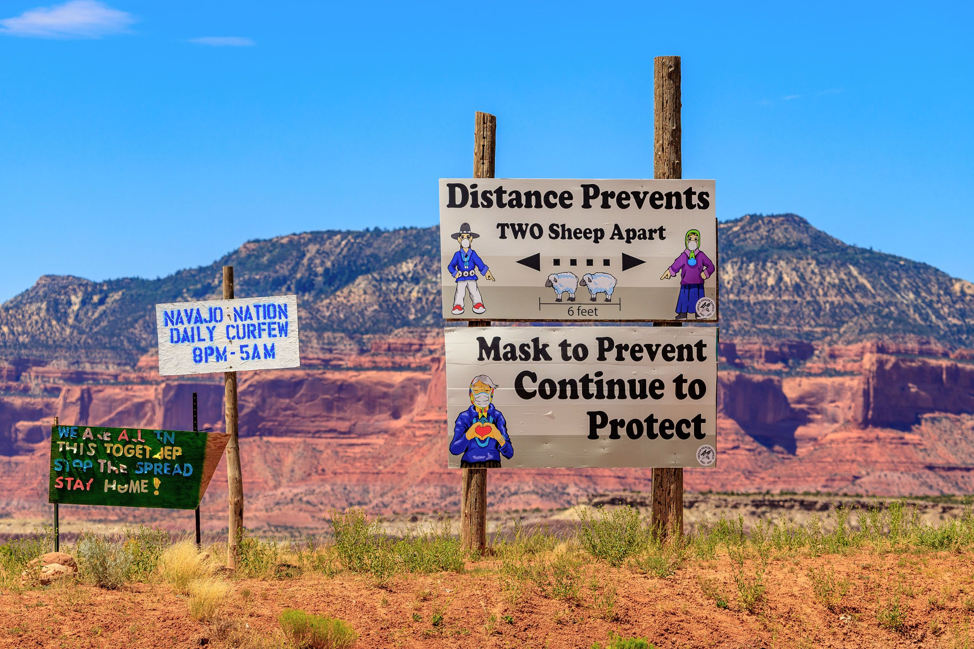
Challenges that Tribes Had with the Pandemic
Tribal Sovereignty – the lack of understanding/respect from state governments and NGOs
Some tribes shut down completely –including tribal offices, making it difficult to coordinate relief efforts and communicate with tribal members
Lack of public knowledge/information and media attention on the needs of tribes in order to respond
Lack of technology and internet access for tribes to communicate to their tribal members and organizations with resources for relief
Notes:
Mark

Slide 14
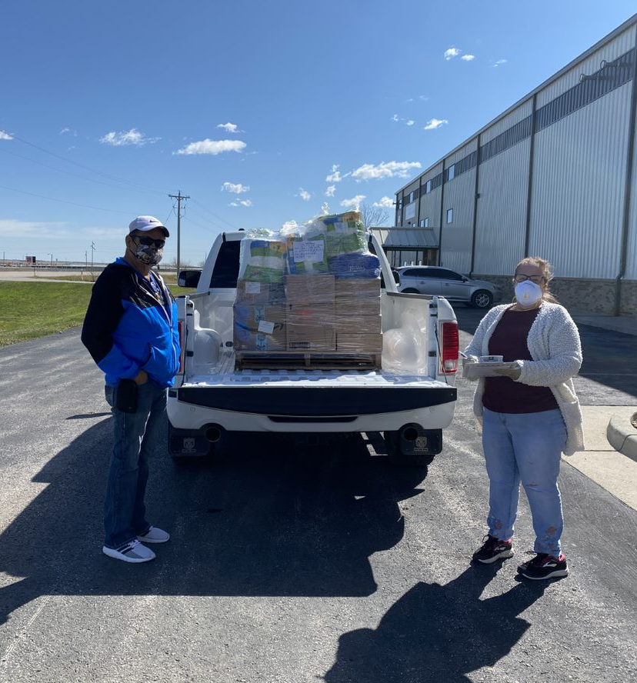
Challenges that Tribes Had with the Pandemic
Restrictions on travel and who could bring relief supplies to the tribe (tribal bureaucracy)
CARES Act funding for tribes was delayed getting to tribes
Chain of distribution of food and other supplies that affected all the USA had a greater significance in Indian Country
Vulnerable Native Americans did not have the resources (food and essential supplies) to shelter-in-place
Notes:
Chele

Slide 15
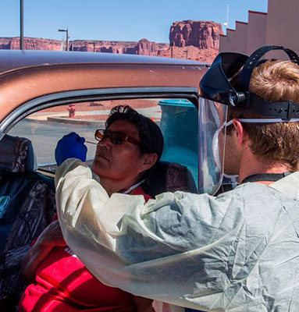
Challenges that Tribes Had with the Pandemic
Stimulus Checks – no banks on reservations
When states/cities opened – Native Americans living in urban areas went back to the reservations (bringing the virus with them)
Isolation in geographically remote reservation communities brought about a rise in depression and suicide cases (domestic violence cases as well)
Lack of testing sites and tests available for tribal members
Inability to do ceremony or rituals
Notes:
Mark

Slide 16
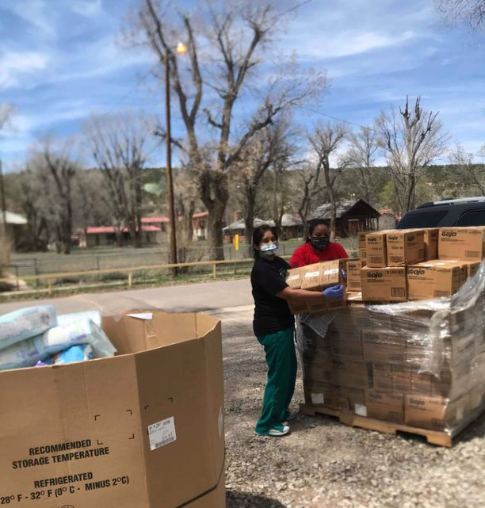
What Worked Well With Tribes During the Pandemic
The practice of Tribal Sovereignty to oversee and coordinate relief to their own tribal members and the ownership of data
Media attention that the Navajo Nation received to bring attention to the impact of the pandemic to tribal communities
Tribal Relief Coordination groups formed to respond to tribal needs during the pandemic and to share information/stats
Funders coming forth to bring outside resources to tribes in need
Stronger emphasis on coordinated relief, review of faulty distribution system and desire for more local Native production of food (families want to have gardens or small farms/ranches)
New leaders and local chapter/community government leadership stepped up to serve the residents in their communities
Notes:
Mark

Slide 17
Ongoing Needs for Tribes as Pandemic Stretches on
Mental Health support and programs
Food, PPE Supplies, essential items (especially in tribal communities that are more geographically remote)
Disaster/Pandemic Training for tribes/tribal leaders/Emergency Managers
Technology infrastructure – internet/cell phone service, laptops, communication systems
Substance Abuse programs/support
Case Management – to assist families, Elders and vulnerable citizens
Medical support (ventilators, medical staff trained to respond to COVID-19 patients)
Youth programs and activities, especially where schools are still not open
Notes:
Mark

Slide 18
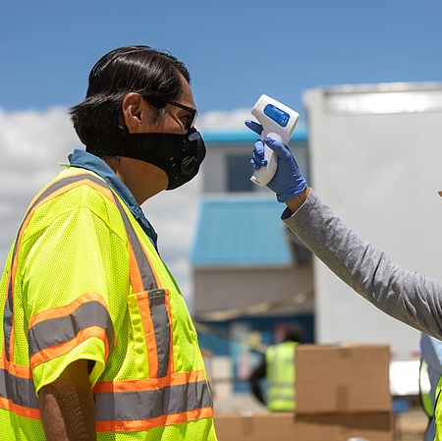
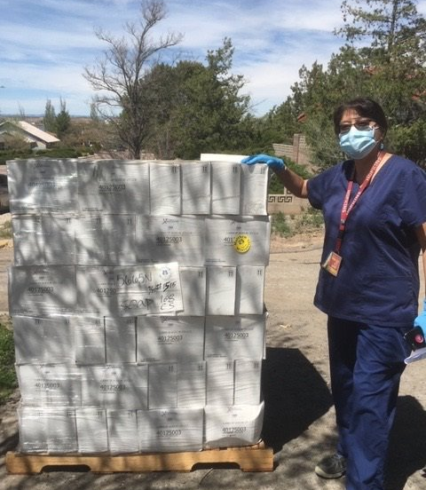
Questions & Comments

