Slide 1
Logistics Lessons from the Record-Breaking
Atlantic Hurricane Season 2020
KATHY FULTON
American Logistics Aid Network
STEPHANIE STEEGE
Airlink
Notes:
Good afternoon, everyone. My name is Stephanie Steege, and I’m the Director of Humanitarian Programs at Airlink. I’m joined today by Kathy Fulton, Executive Director of the American Logistics Aid Network, or ALAN.
Today, we’ll be talking about the lessons our organizations learned while responding to a record-breaking Atlantic hurricane season in the midst of a global pandemic.
Coordination is challenging in any disaster, but it is especially difficult during large-scale events like COVID-19, a worldwide emergency that has forced nonprofits to quickly scale up their capacity to address the most pressing needs.
In 2020, voluntary organizations were impacted at their core; driven to reimagine their operations, they questioned whether it was responsible or feasible to carry out volunteer-powered responses, as well as how to mobilize supplies to keep volunteers, both local and out-of-state, safe while still helping communities recover.

Slide 2
About this Session
Goal 1: Participants will learn about the challenges faced by logistics providers and implementing agencies alike as they responded to the 2020 Atlantic Hurricane Season, and how these issues drove the evolution of the in-kind transportation model.
Goal 2: Participants will learn how they can help their organizations mitigate the risk of market volatility in responses through preparedness activities and strategic partnerships.
Goal 3: Participants will explore the role that nonprofit logistics providers play in rapid-onset emergencies in order to empower logistics preparedness and cultivate collaborative responses rooted in partnership.
Notes:
The goals of this session are on the screen. Broadly, we hope you will leave this session with a unique perspective on logistics as the backbone of response and an understanding of areas for operational growth within your voluntary agency’s operations. Ultimately, this session should help you identify next steps to build strategic partnerships that will enhance the ability of both individual organizations and the nonprofit community to handle uncertainty and volatility in program delivery as we mainstream COVID-19 programming.
Today, we’ll give you a quick overview of both of our organizations, talk about the wins and the challenges of operating during the last hurricane season, present a couple of case studies on logistics complexities during the back-to-back responses last year, and close with some actions you can take now - before June 1st (or even before the peak of hurricane season in September) - and some resources you can take back to your organization to help.

Slide 3
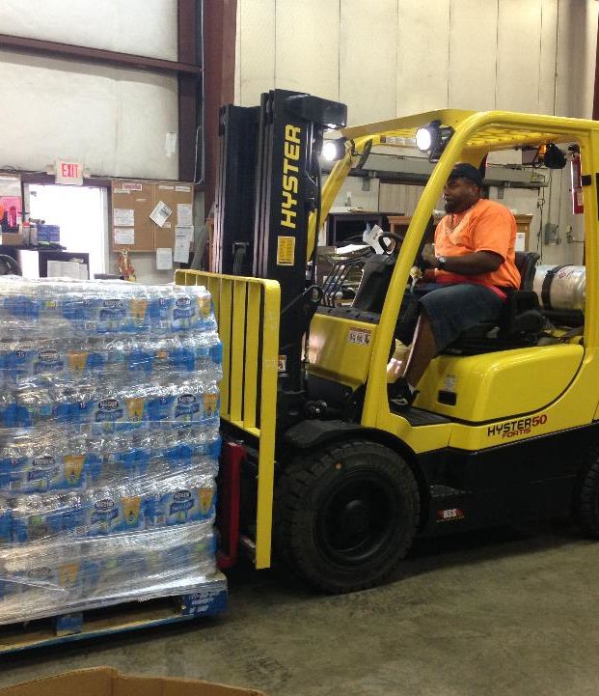
About American Logistics Aid Network
ALAN delivers supply chain information, services, and expertise to ensure those affected by crisis have the nourishment, hydration, and medical care they need when they need it.
We engage industry to support crisis response by convening unifying conversations, educating those that require logistics / disaster knowledge, informing all organizations with situational awareness during a crisis event, and coordinating the movement of materials as events unfold.

Slide 4
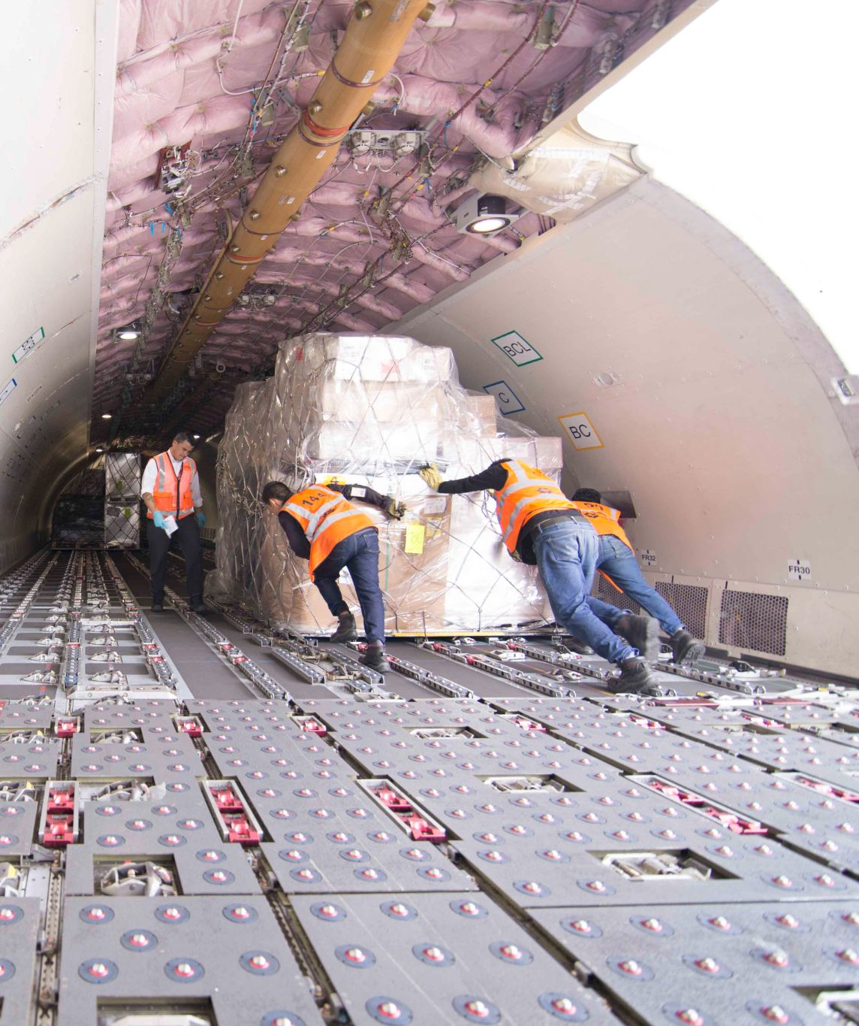
About Airlink
Airlink is a nonprofit organization working with aviation and logistics partners to transport relief workers and emergency supplies for NGOs responding to natural disasters and other humanitarian crises around the globe.
Our goal is to harness the power of the aviation industry to help NGOs redirect logistics funding to programming that helps communities in crisis.
50
airlines
130
NGOs
+$12M
saved
Notes:
Airlink is a nonprofit organization working with aviation and logistics partners to transport responders and emergency supplies for nonprofits responding to natural disasters and other humanitarian crises around the globe.
Our goal is to harness the power of the aviation industry to help charities redirect logistics funding to programming that helps communities in crisis.
In the continental US, most of our work is passenger-focused, so that’s most of what I’ll focus on today. Personnel logistics was difficult to say the least in 2020!

Slide 5
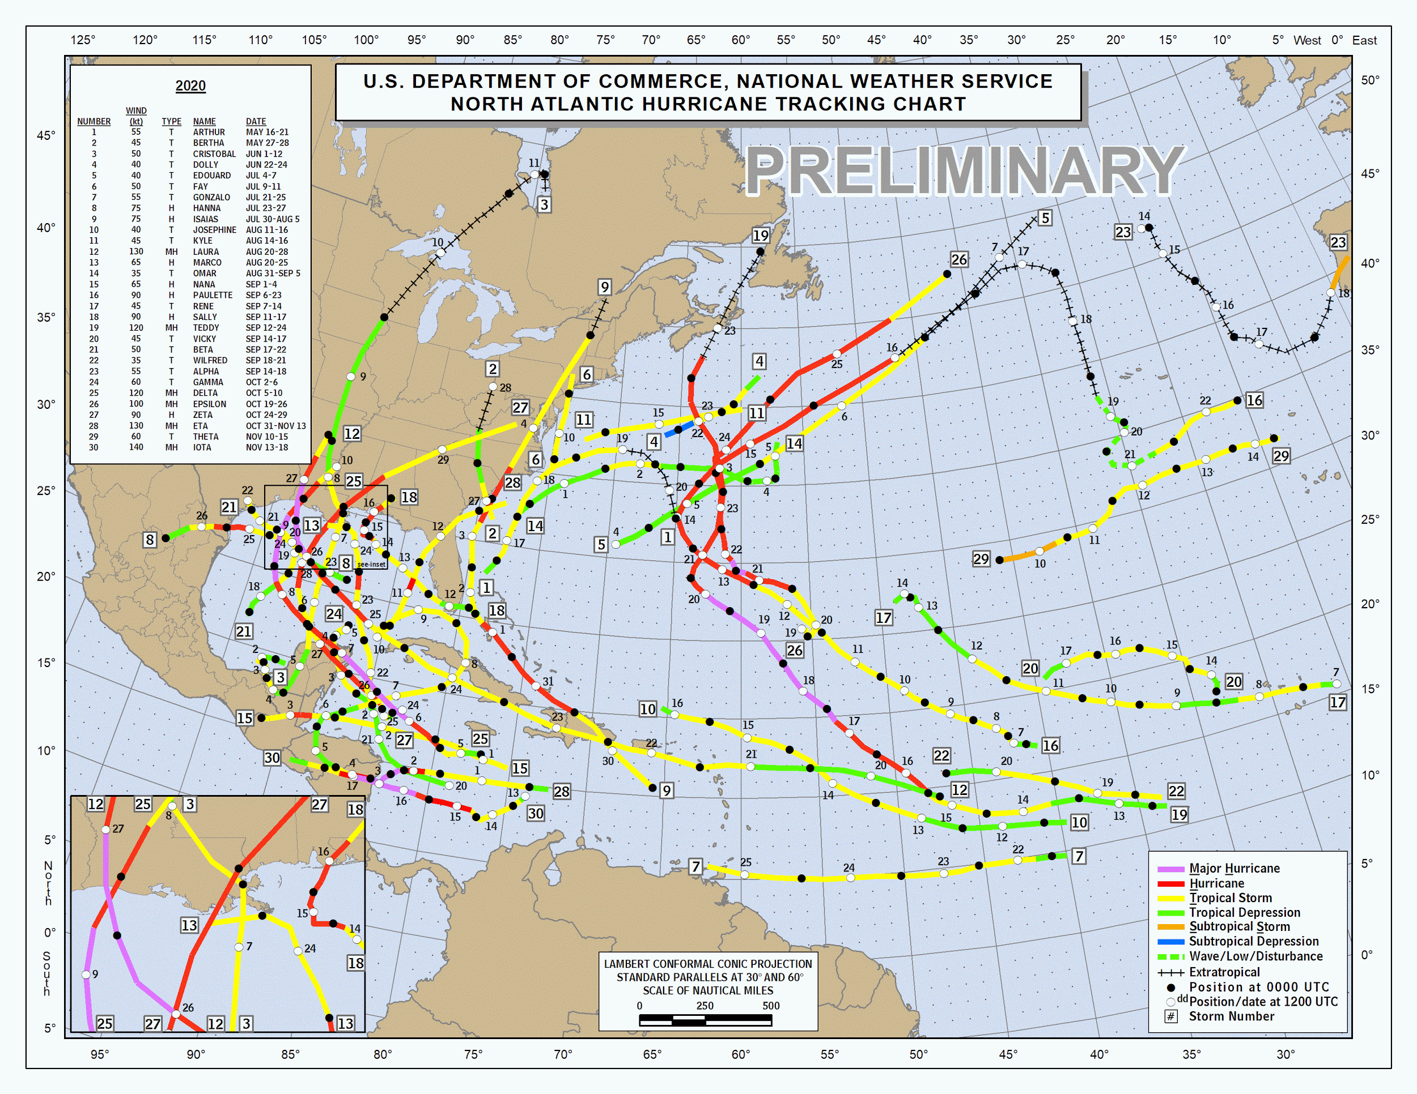
Hurricane Season 2020
Record number of named storms & major hurricanes
$47 billion in damage in 2020
Hundreds of thousands of people affected
Recovery has been complicated by COVID-19
https://www.nhc.noaa.gov/data/tcr/
Notes:
The record 2020 season featured an unheard-of 30 named storms that caused 47 billion dollars in damage. Hundreds of thousands of people were displaced by the storms - left without clean water and shelter in the midst of the pandemic.
In the United States, 2020 was the fifth consecutive above-normal season. As far as logistics is concerned, we know to be prepared for these dramatic peaks in demand now, but each year, it is still difficult to keep up.

Slide 6
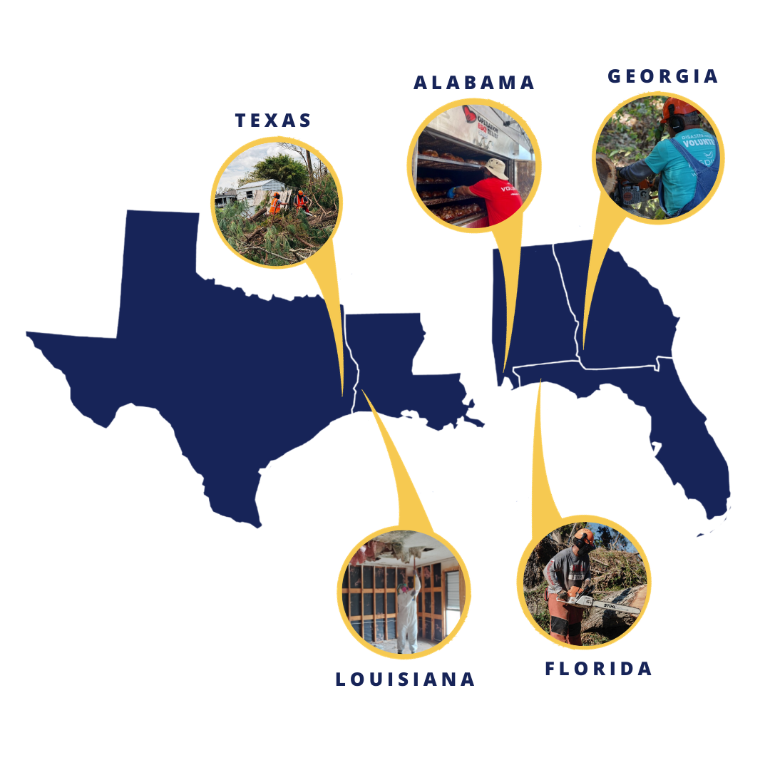
Hurricane Season 2020 - Airlink’s Response
12 NGOs
$280,000 in transportation relief
+400 responders deployed
870,000 hot meals distributed
650 families provided with clean water
4,000 people provided with healthcare
1,600 families provided with shelter

Slide 7
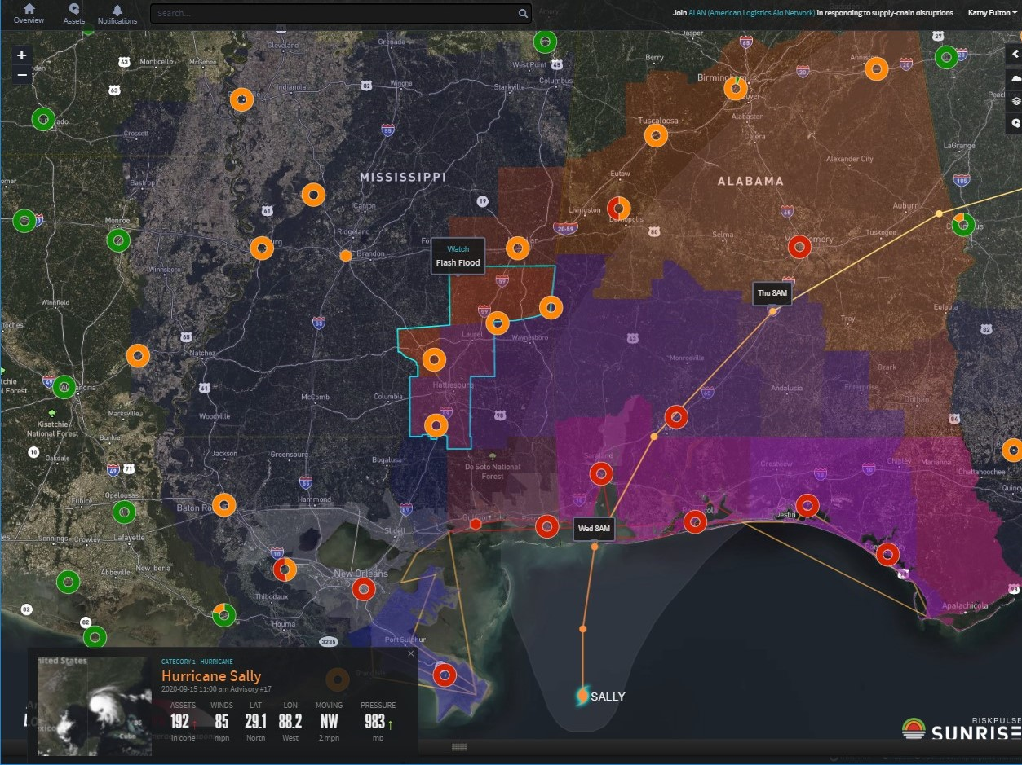
Hurricane Season 2020 - ALAN’s Response
6 NGOs
2 warehouses
5 pallet jacks
15 truckloads of food, water, hygiene, pallets, boxes
12,000+ miles
600+ Intelligence Center users
Alongside ongoing COVID operations

Slide 8
Cross-sector challenges
Business Community
Employee health / safety / absenteeism / essential employee regulations
Patchwork of regulatory requirements differing across state / municipal boundaries
High/low demand swings
Supply chain design adaptations
Nonprofit Community
Responder / volunteer safety
Shift to non-congregate sheltering for survivors
Responding organizations must be self-sufficient
Donor fatigue
Shortages throughout the supply chain
Notes:
KF - Biz community challenges
SS - Nonprofit community

Slide 9
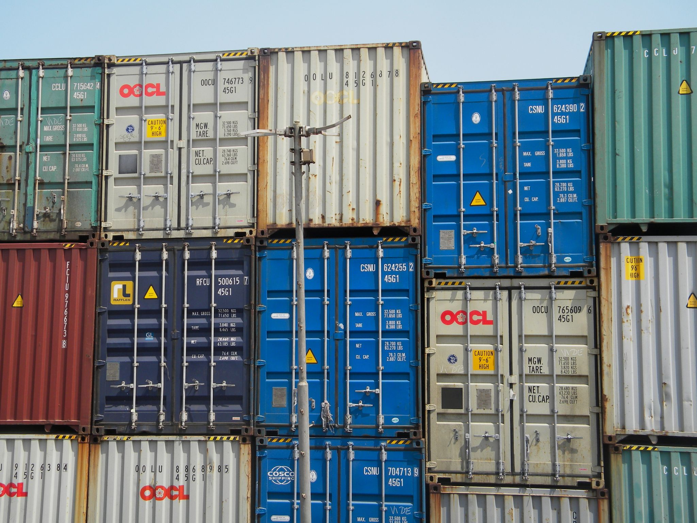
Case Study: Ill Defined Requirements
Initial Requirement: Warehousing and handling for 2000 sqft, 23,000 lbs of pallets, boxes, and crates; arriving in 2 - 3 shipments over 7 - 10 days time; minor palletization; ship all at once within 2 - 3 weeks
Actual Project: 32 x 20’ sea containers over 1 month time frame, 100+ off-sized pallets, floor loaded materials, etc.; cross-docked, repack, shipping
Challenge: Reputational risk for nonprofit, ALAN, and all nonprofits; potential delays of resource in high demand
Actual Outcome: Materials were delivered to the right place at the right time, right quality, quantity; business has continued to donate services

Slide 10
Case Study: Non-traditional Partners
Initial Requirement: Pallets to stage / sort items donated for Hurricane Laura response
Challenge: Pallets were in short supply from traditional partners due to supply chain re-configuration and demand swings
Solution: A green energy company in New Orleans had recently received a shipment of materials and was seeking to recycle / dispose of pallets.
Outcome: Donated items were able to be sorted and distributed to hurricane evacuees at the right place, right time, right quality, quantity.
Notes:
When traditional supply chains are constrained, there may be opportunities to work with non-traditional, local partners. But it still requires relationships ahead of time.

Slide 11
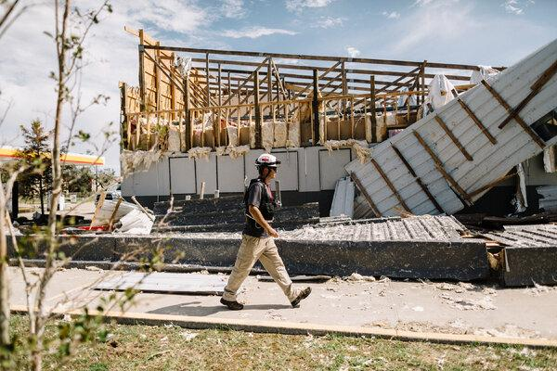
Case Study: Donor-Amplified Partnerships
After a low start to the year for passenger travel, Hurricane Season 2020 overwhelmed the Southeast with demand for passenger flights.
Challenge: Mismatch of flight supply and nonprofit passenger demand; inconsistent and changing safety needs.
Opportunity: Working with an existing donor to help make the case for disaster-time support through one of their corporate customers
Outcome: Influx of cash for supply chain support at the right time, which resulted in meeting 100% of demand, as well as profile for the donor.
Notes:
After a low start to the year for passenger travel, a few things happened: airlines scaled back their flights to lower-traffic destinations across the US and around the world, and also decreased their commitments to nonprofit partners with respect to passenger capacity. With WFH becoming a way of life, corporate travel budgets went unused. And nonprofit organizations were sending few if any people into the field for responses - relying on local partners.
When the 2020 Atlantic Hurricane Season ramped up, we saw a substantial increase in passenger requests, with organizations responding to Hurricane Isaias in North Carolina, Hurricanes Laura, Delta, and Zeta in Louisiana, and Hurricane Sally in Florida and Alabama. To be honest, Airlink was initially overwhelmed with requests. There was a huge mismatch of flight supply (just one flight per day going from Houston to Lake Charles, for instance) and nonprofit passenger demand. Those organizations that were responding - perhaps for the first time that year with out-of-state resources - also needed their volunteers to safely socially distance from other passengers - which frequently meant buying out the middle seat of every row at a premium. So a regular 37-passenger aircraft flying Houston to Lake Charles was at full capacity with just 25 passengers - 67% capacity when every single seat was needed. With demand into Lake Charles (in particular) so high, we saw flight prices as high as $1500 for a single, one-way ticket.
We raised this with one of our longest-standing donors, United Airlines, to see if any further resources were available to help with the hurricane response - knowing full well that the airline industry had suffered a huge blow to revenue in 2020. They noted that one of their largest corporate customers - Deloitte - had unused flight credits that they had purchased at the beginning of the year for employee travel - and it was about to expire! Knowing that, if anyone could use it to make an impact, it would be Airlink, they quickly made the connection so that those resources could be used to buy flights.
Thanks to United Airlines and Deloitte, Airlink launched a sustained, robust response (and now recovery effort) to Hurricanes Laura, Sally, Delta, and Zeta, sending in some 400 responders from US and Canada - we ended up meeting 100% of the demand that came our way, despite initial worry about whether we would have enough resources to meet the needs. These responders worked to rescue people trapped by flooding; provide hot meals, emergency medical aid, and clean water to vulnerable communities including the deaf and hard of hearing; and remove debris and repair homes where possible. And this donation is still powering long-term recovery today.
This kind of “amplified” giving, where our donors are using their connections to help us expand and connect with their corporate customers - has now become standard practice, thanks to this successful match.

Slide 12
Preparing for Hurricane Season 2021
You can outsource activities but you can't outsource risk.
Ultimately, trucking and air capacity were among the most heavily impacted industries last year, and all operations around the world - including the responses to Hurricanes Laura, Sally, Delta, and Zeta - were drastically under-resourced as a result.
Build Early Partnerships
Advance Staff Training
Pre-Scripted
Plans
Notes:
SS - Build early partnerships with donors, vendors, logistics providers. And make sure that logistics is part of your program design, not just a way to get things to a program.
SS - At Airlink, we talk to our partners a lot about advance training of staff. We have logistics partners that can provide training on dangerous goods (how to send items like hand sanitizer in emergencies!), but we can also help your teams understand in advance how to request flights through the Airlink portal, too.
KF - just ditto
KF - Pre-scripted plans and packages. Along with the relationships, and training, build plans. Even if they change, you have an idea of what you want to accomplish.

Slide 13
Resources
Airlink Logistics Preparedness Guidance - https://airlinkflight.org/resource/air-logistics-preparedness-guidance-note/
ALAN Supply Chain Intelligence Center - https://www.alanaid.org/map
Nominate a business that deserves recognition! - https://www.alanaid.org/humanitarian-awards-nomination/
When you’re in the midst of a disaster, it may be too late!
Explore how partnership with ALAN and Airlink can help now - before peak hurricane season.
Kathy Fulton, ALAN - ops@alanaid.org
Stephanie Steege, Airlink - ops@airlinkflight.org

Slide 14
Have questions?
Let’s address them in the Chat now!
For more information about the organizations in this presentation contact us at…
Kathy Fulton, ALAN - ops@alanaid.org
Stephanie Steege, Airlink - ops@airlinkflight.org

