Slide 1
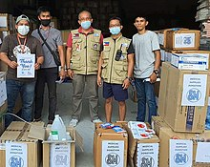
New Donations Management Opportunities for Collaboration and Safety in a Pandemic.
Your Presenters
Charlene Sargent
Adventist Community Services
Don Bonchack
FEMA
Dante Gliniecki
Independence MO EM
This Photo by Unknown Author is licensed under CC BY-SA

Slide 2
The VOAD Perspective Charlene Sargent
New Donations Management Opportunities for Collaboration and Safety in a Pandemic.
Adventist Community Services

Slide 3
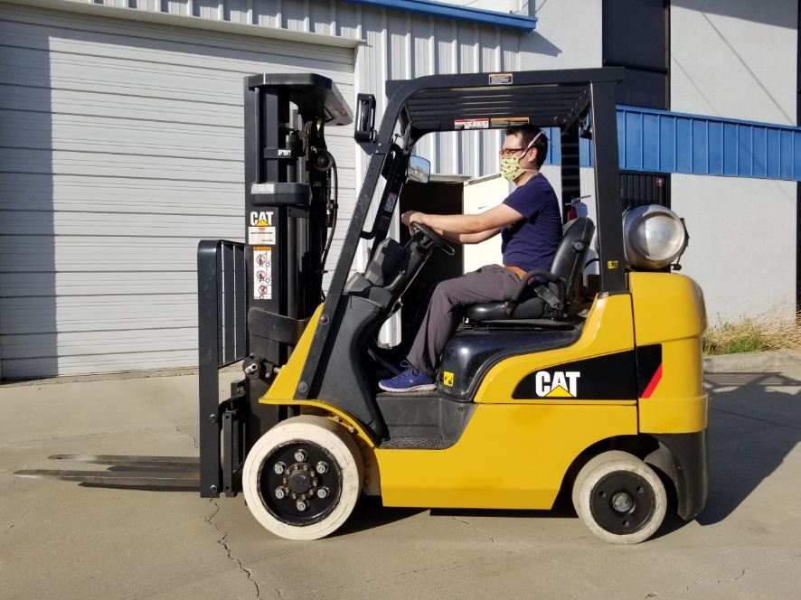
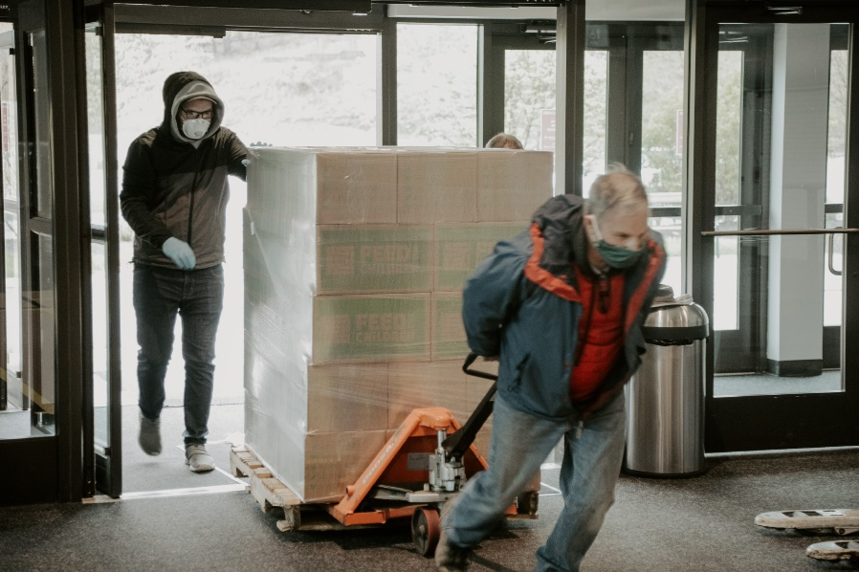
Volunteer Considerations
Sick – Stay Home
Limit Travel
Daily Check
Temperature
Symptoms
Exposure
Travel
Testing
Quarantine/Isolation
Documentation (contact tracing)

Slide 4
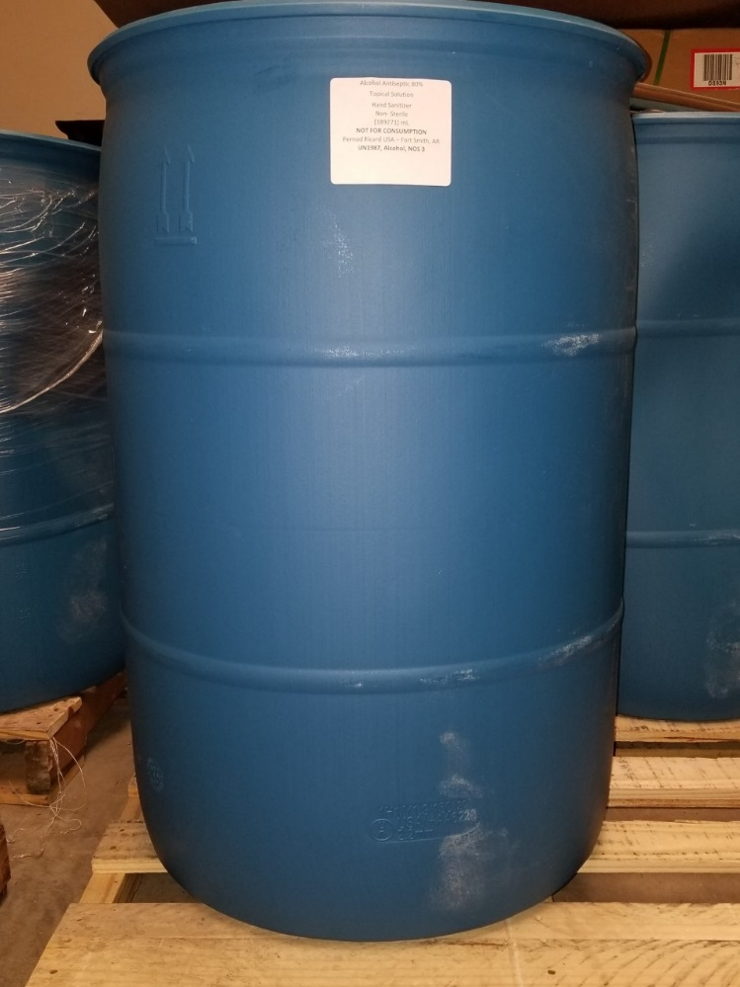
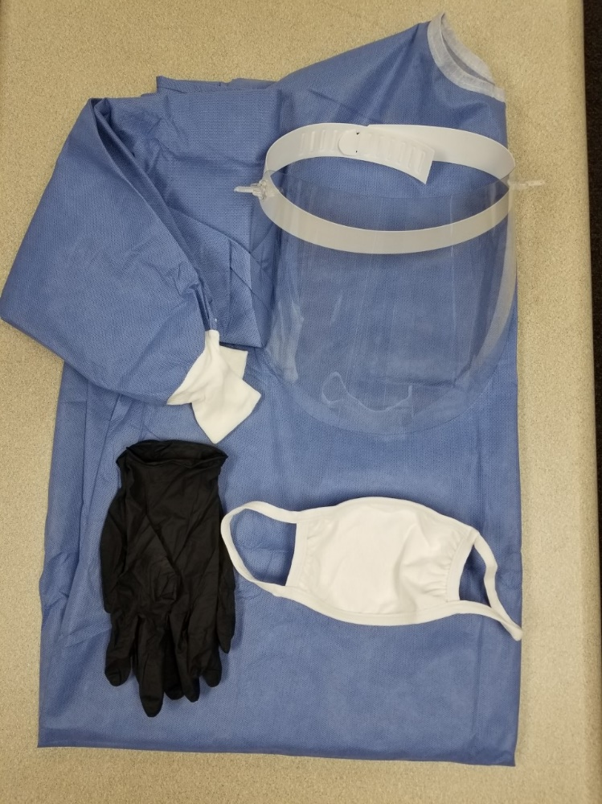
Volunteer Safety
Volunteer Education
Social Distancing
Hand Washing
Coughs/Sneezing
No Touching Face
Donning & Doffing PPE
Masks (N95, KN95,
Cloth, other)
Face Shields
Gloves
Gowns
Ventilation/Air Purifiers

Slide 5
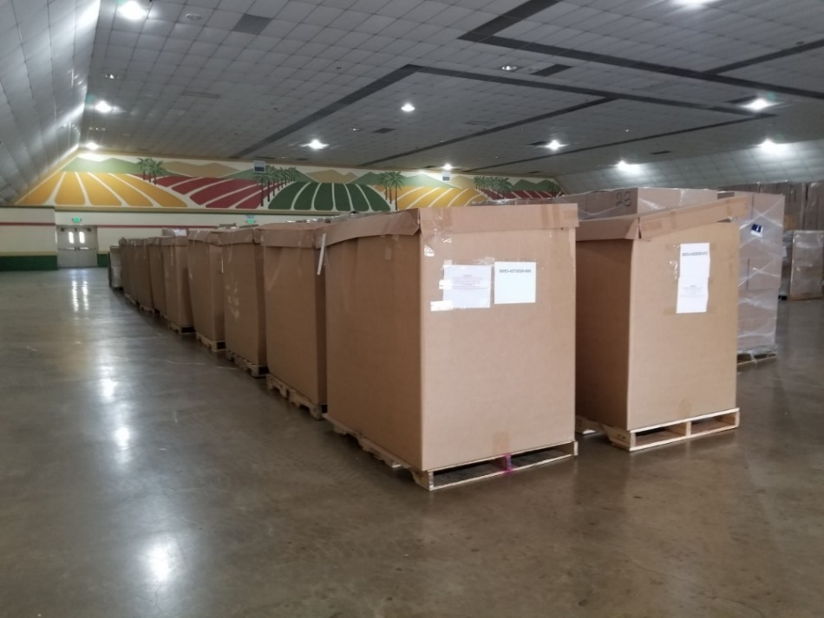
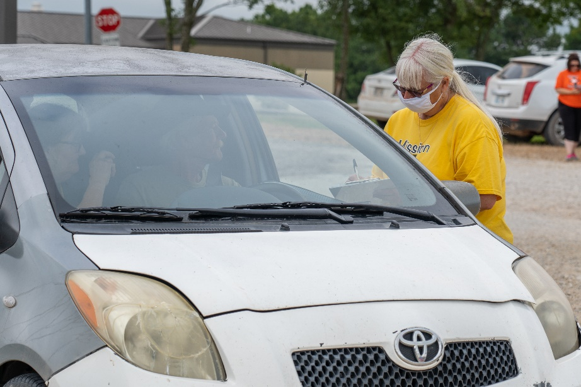
Operational Considerations
Social Distancing
Sanitation
Hand Washing
Hand Sanitizer
Disinfect Shared Items
Outdoor vs. Indoor Operations
Weather
Food and Beverages
Traffic Control
Signage

Slide 6
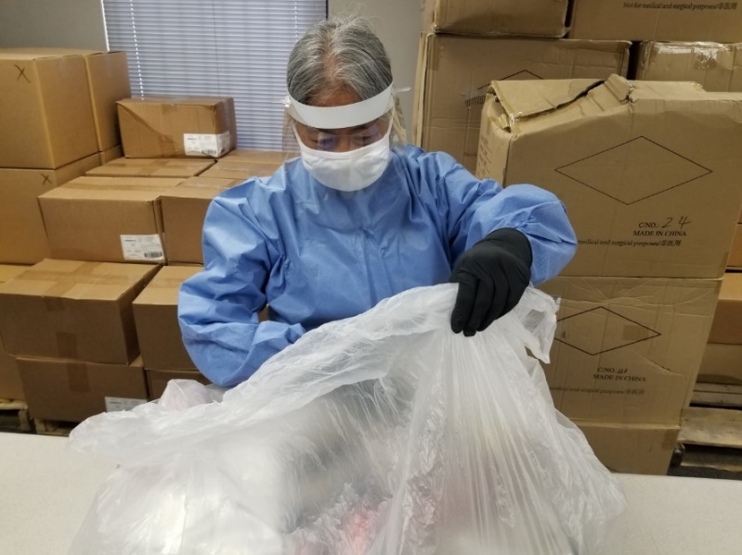
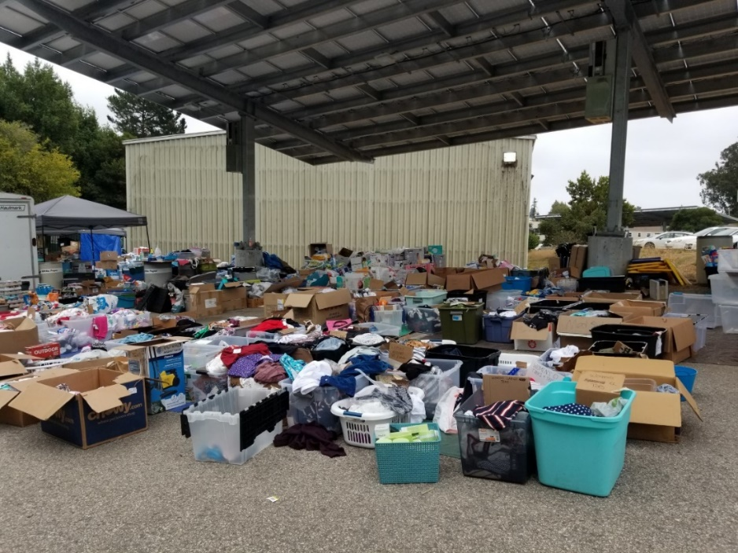
Collecting Donations
Cash is Preferred
In-kind Donations
New Items Only
Original Packaging
No-touch Drop-off
Isolate (3-7 days)
Disinfect
Launder Used Clothing

Slide 7
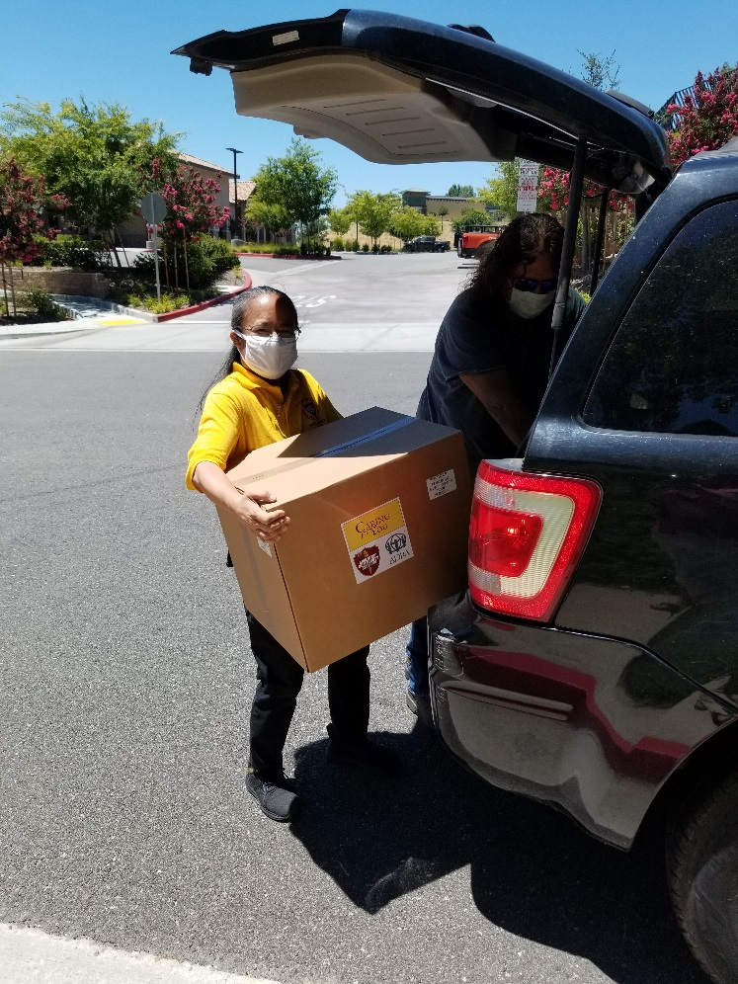
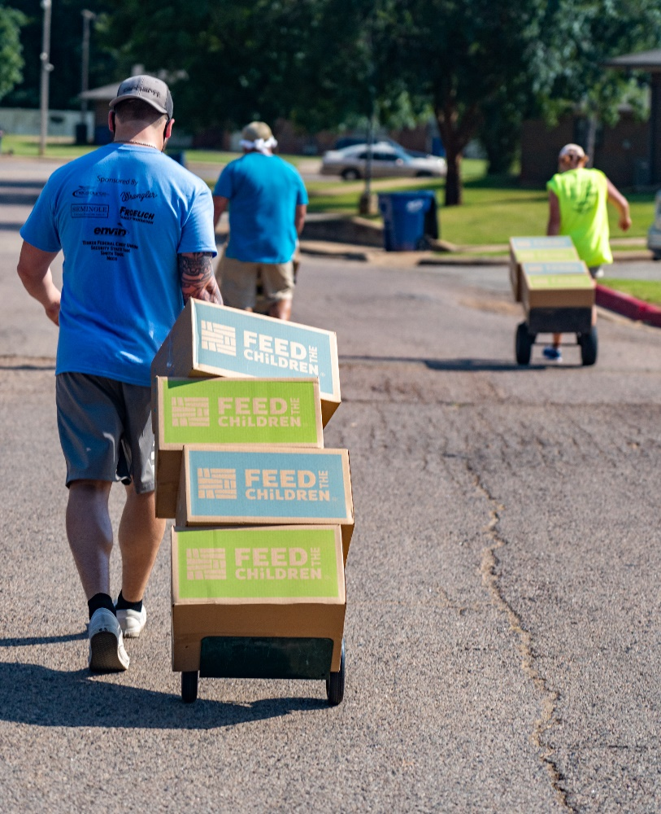
Distributing Donations
Pre-register recipients
Pre-package Items
Drive-through
Remote Pick-up
Partner Organizations
Food Insecurity
Healthcare
Government

Slide 8
The Federal Perspective Don Bonchack
New Donations Management Opportunities for Collaboration and Safety in a Pandemic.
FEMA Headquarters

Slide 9
Donations Unit at FEMA HQ stood up to support NRCC for COVID, March 2020
Virtual team - to support Regions/operations and match offers to needs
Non-stop for over a year
Adjudicated 3000+ inquiries
For Sale - International - Volunteers - Donation offers
Completed 300+ donations offers
Vetting offers: Product ? Quantity ? Location? Availability ? Packaging ? Transportation ? Preference of donor ?
Best way to contact us: FEMA-Donations-MGT@fema.dhs.gov

Slide 10
Numbers to date:
Matched over 177,000,000 various donated goods and services including
Masks (all types): Over 109 Million (107 America Strong)
Medical Supplies: Over 9 Million
Non-surgical gowns: Over 2 million
Face Shields: 235,000
Hand Sanitizer: Over 1 Million bottles, 551,000 gallons
Gloves: 1 million
Protective Goggles: 504,000
Pharmaceuticals: 12 Million units
Food: 415,500 cases
Water: 70,000 cases

Slide 11
Keys to Success
3 Pillars
Donor Intent
Where Needed Most across the USA
Fair and Equitable matching
Customer Service
Donor and recipient has easy access to team (common mailboxes – FEMA.gov)
Early and often communications with everyone: phone/email/reports/VOISE

Slide 12
Keys to Success (continued)
Coordinate Transportation and Ensure Delivery
FEMA tracks delivery
Transportation by donor, recipient, or donated by another party
When transportation is not available, FEMA may provide transport.
Recipients
Non-profit orgs at all levels (National to hyper local)
FEMA Regions, Tribes and States (fill resource requests)
Schools, House of Worship, Hospitals, Fire Companies, etc.

Slide 13
Keys to Success (continued)
Maintain awareness of all disasters across the nation
Who is doing what? Where are the needs? Where are the donations?
VOAD Bi-weekly Ops Call. State VOAD calls. NRCC calls.
All hazard response Big - Small - Non-declared - ongoing
COVID, CA wildfires, hurricanes, flooding, TX/OK winter storms, border crossing.

Slide 14
The State Perspective Dante Gliniecki
New Donations Management Opportunities for Collaboration and Safety in a Pandemic.
Independence MO Emergency Preparedness

Slide 15
New Donations Management Opportunities for Collaboration and Safety in a Pandemic. The Local Jurisdiction Perspective
The Local Jurisdictional Perspective
Local jurisdictions discovered and or greatly benefited from donations during pandemic response.
Donated goods included the following:
Personal Protective Equipment
Sanitizer
Medical supplies
Donated dollars
Volunteers

Slide 16
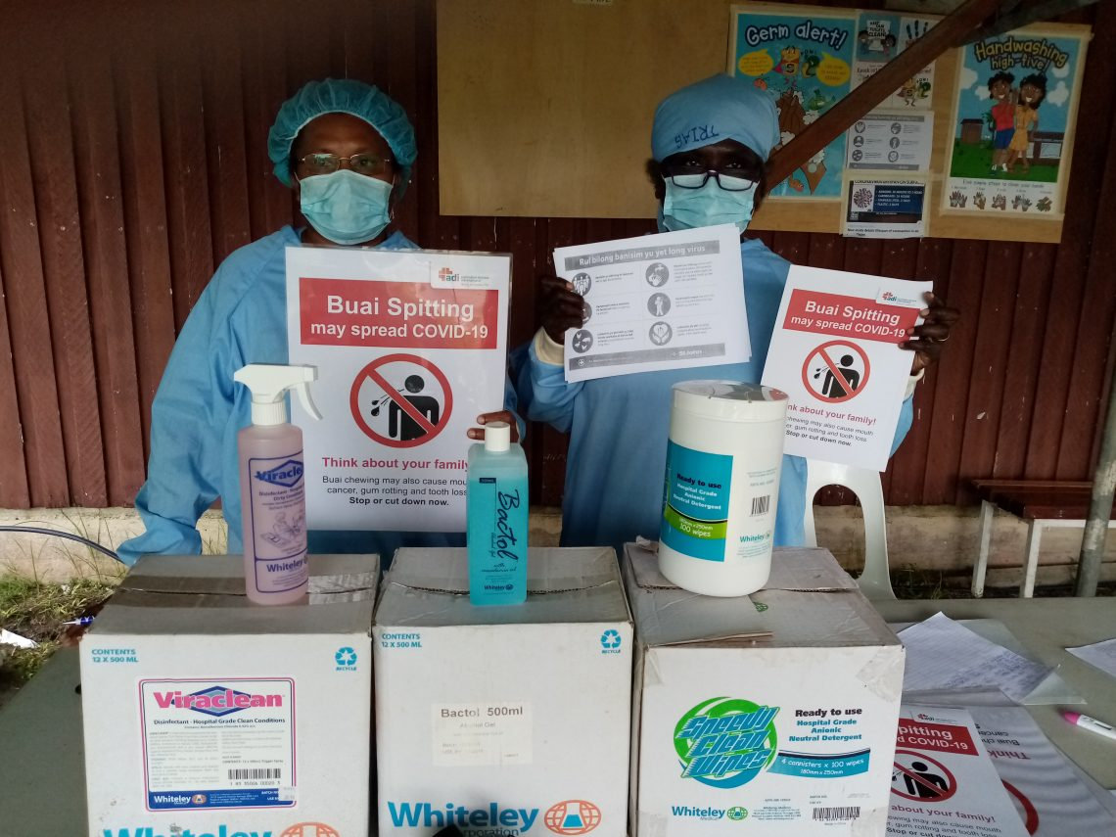
New Donations Management Opportunities for Collaboration and Safety in a Pandemic. The Local Jurisdiction Perspective
Sources of donated goods
States
Dept. of Heath
State emergency management agencies
Surplus property
FEMA
VOAD and faith-based organizations
Corporations
Regional coordination centers

Slide 17
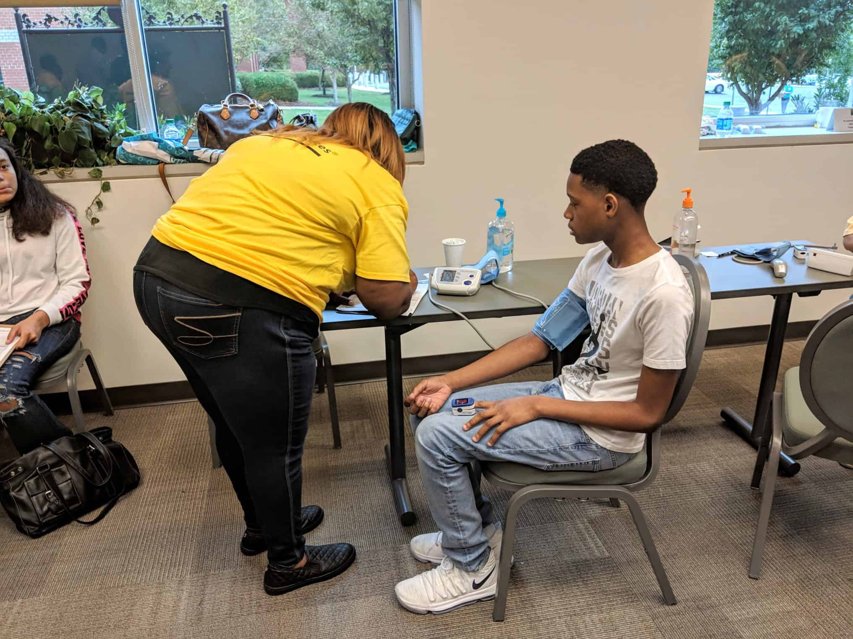
New Donations Management Opportunities for Collaboration and Safety in a Pandemic. The VOAD and COAD Perspective
The VOAD and COAD Perspective
State VOAD and local COADs played a major role in donations management .
VOADs and COADs roles in donations management included the missions that :
Distributed and managed donations of Personal Protective Equipment, medical supplies and equipment
Managed donated dollars
Managed volunteers
Coordinated between agencies, jurisdictions, stakeholder and requesters

Slide 18
New Donations Management Opportunities for Collaboration and Safety in a Pandemic.
The State Jurisdictional Perspective
States had access to regular allocations of needed goods.
Distribution of goods to local agencies included the following:
Personal Protective Equipment
Sanitizer
Medical supplies
Vaccine
Vaccination supplies
Sources of donated goods
Federal departments
Heath and Human Services
FEMA
CARES Act
State agencies
Corporate partners
Hospitals and health care providers

Slide 19
Let’s address those questions in the Chat now
Charlene Sargent: Adventist Community Services
(charlene.sargent@adventistfaith.com)
Don Bonchack: FEMA
(Don.Bonchack@fema.dhs.gov)
Dante Gliniecki: Independence MO EMA
(dgliniecki@indepmo.org)

Slide 20
New Donations Management Opportunities for Collaboration and Safety in a Pandemic.

