Slide 1
West Street Recovery
“Survivors as Experts”
West Street Recovery

Slide 2
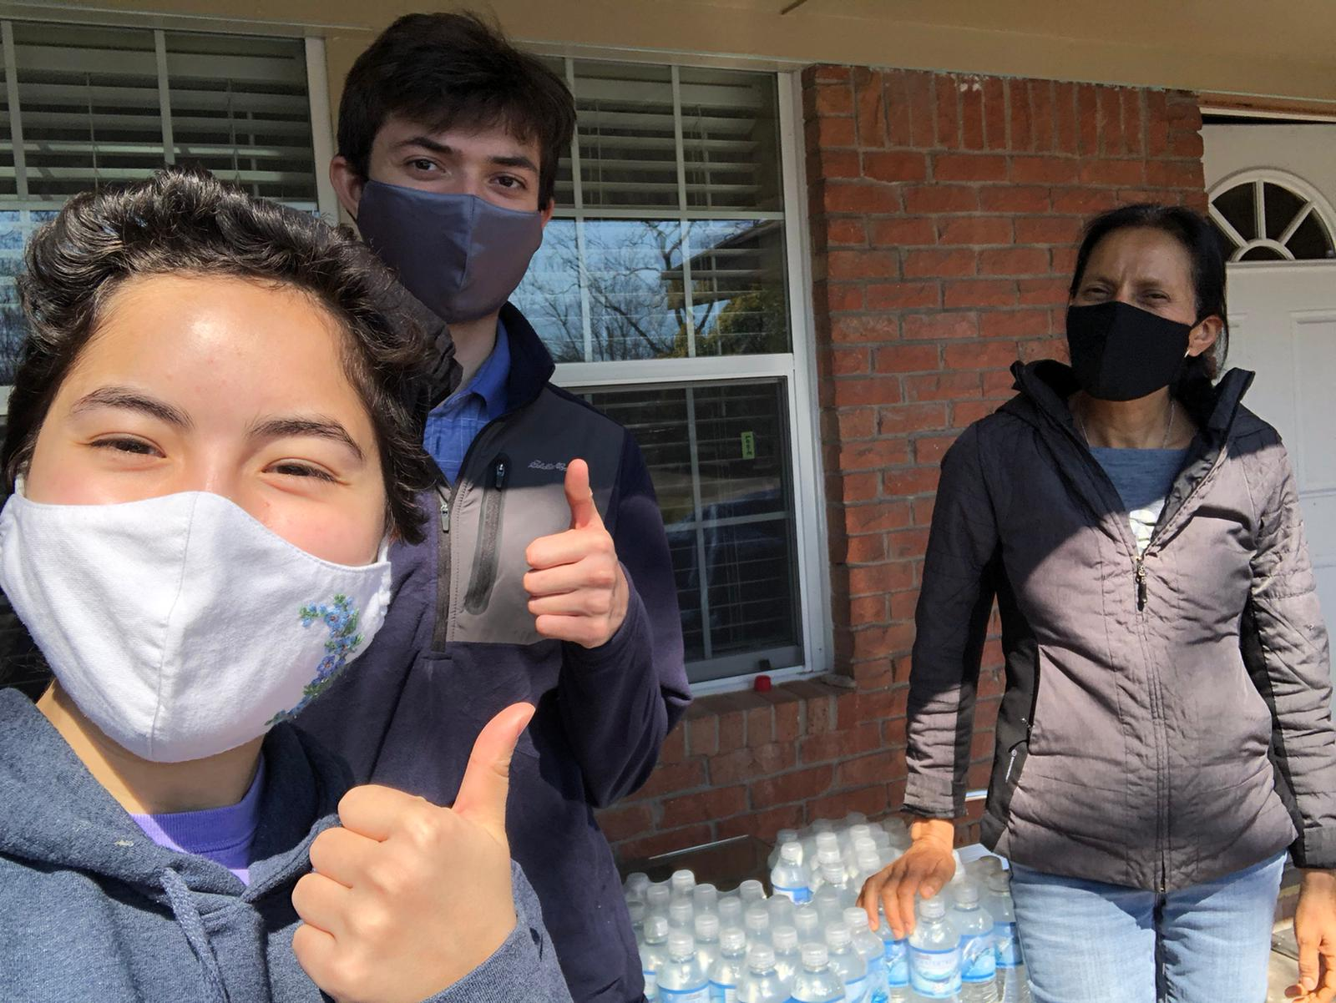
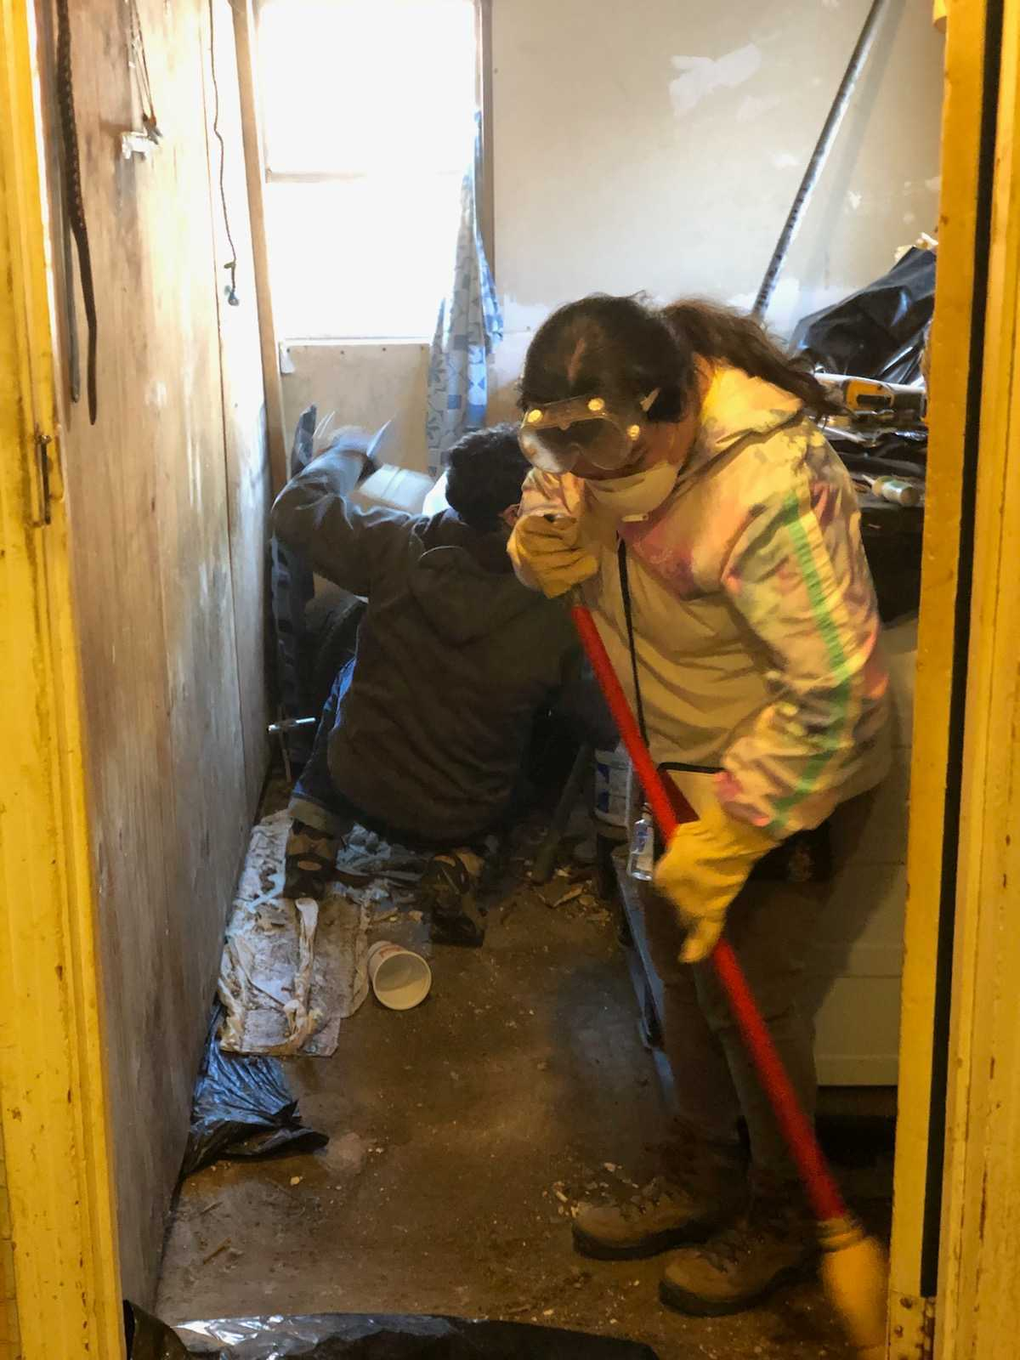
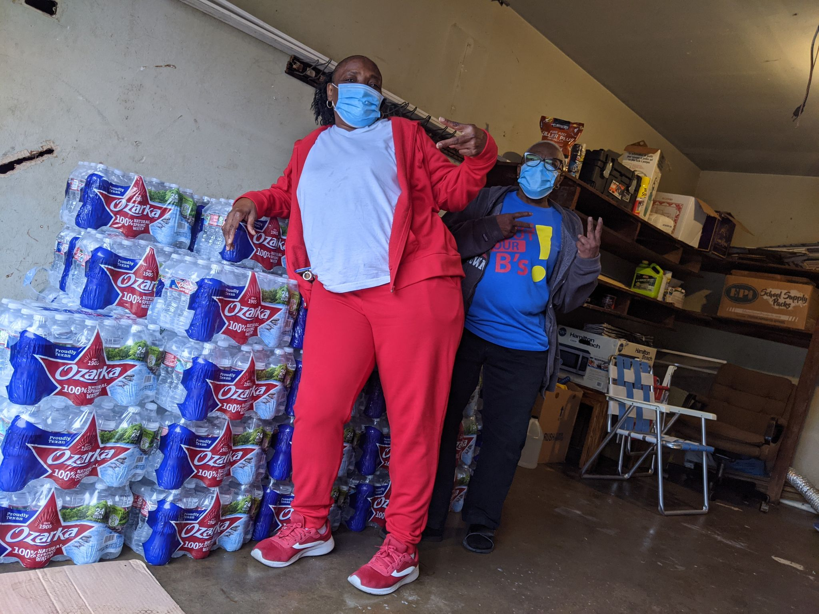
Barrier Analysis:
What are the barriers households and individuals face when trying to overcome disaster?
What steps need to be taken so that the barriers can be overcome?
Who are the actors responsible for overcoming each barrier?

Slide 3
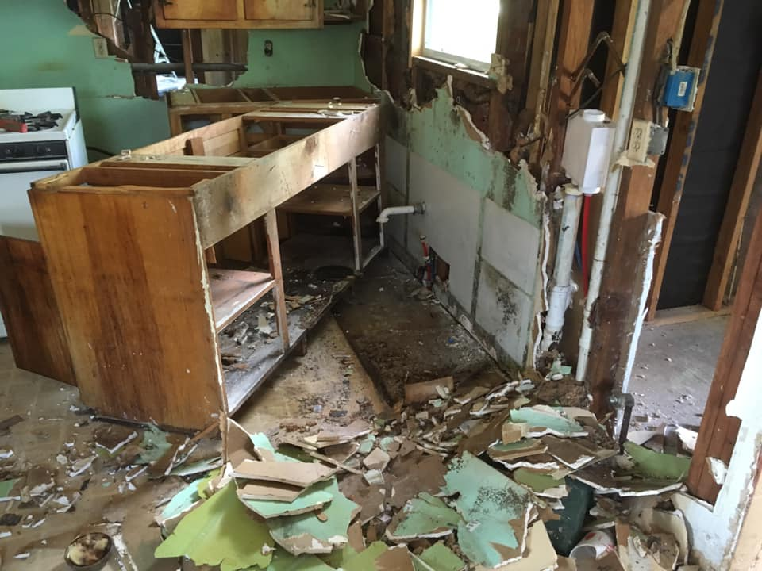
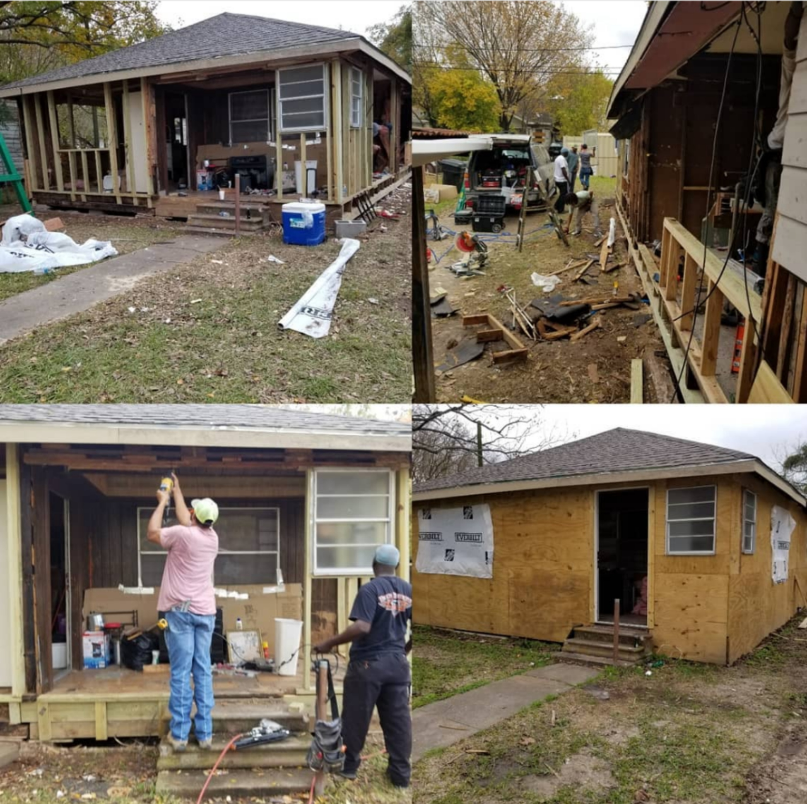
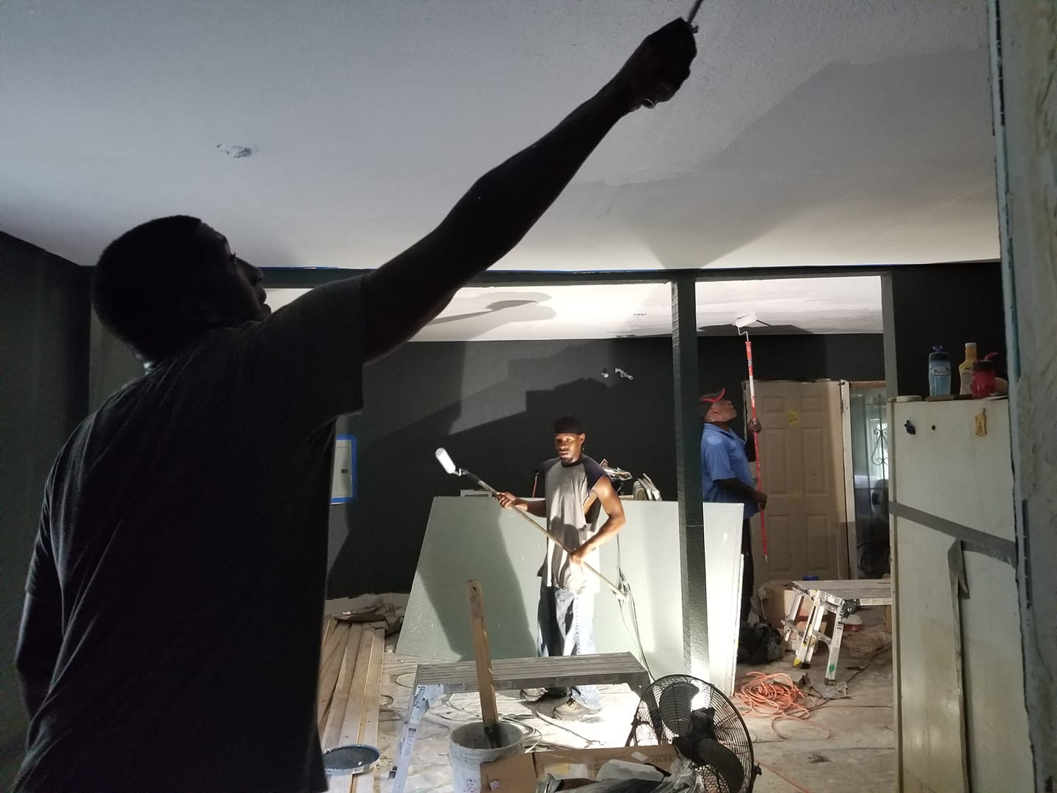
Construction
Construccion

Slide 4
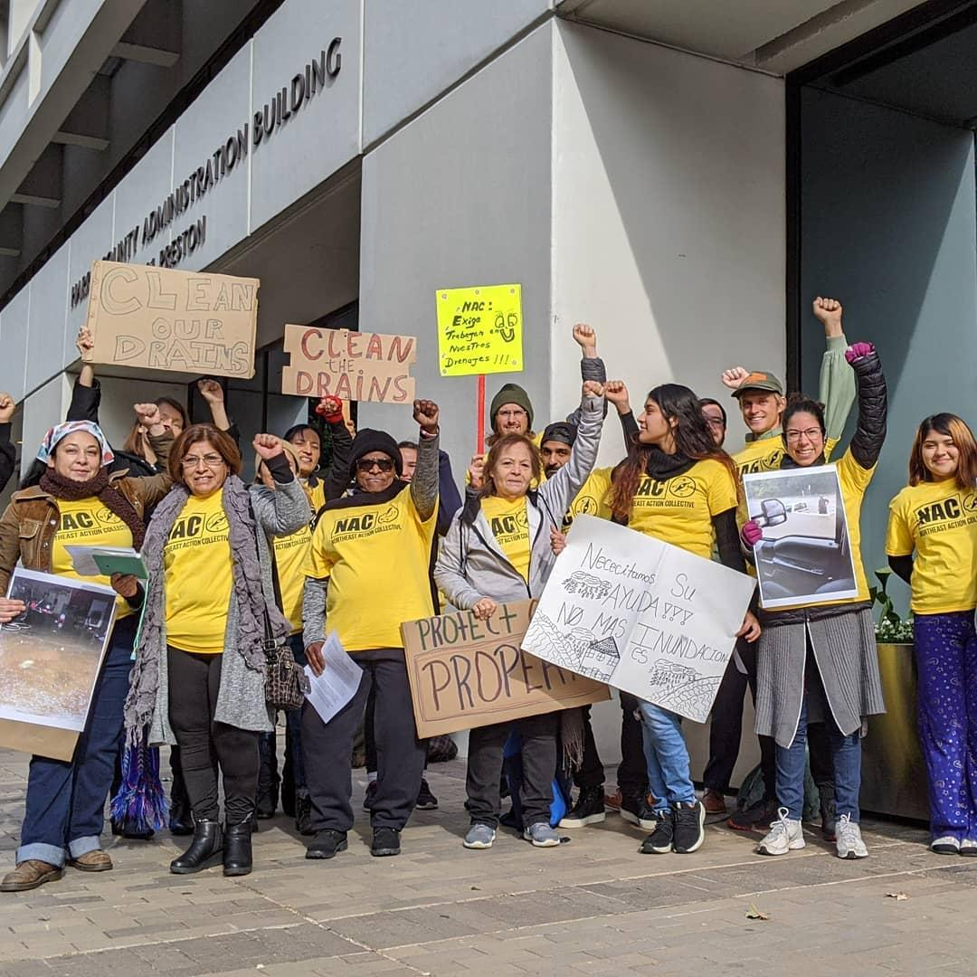
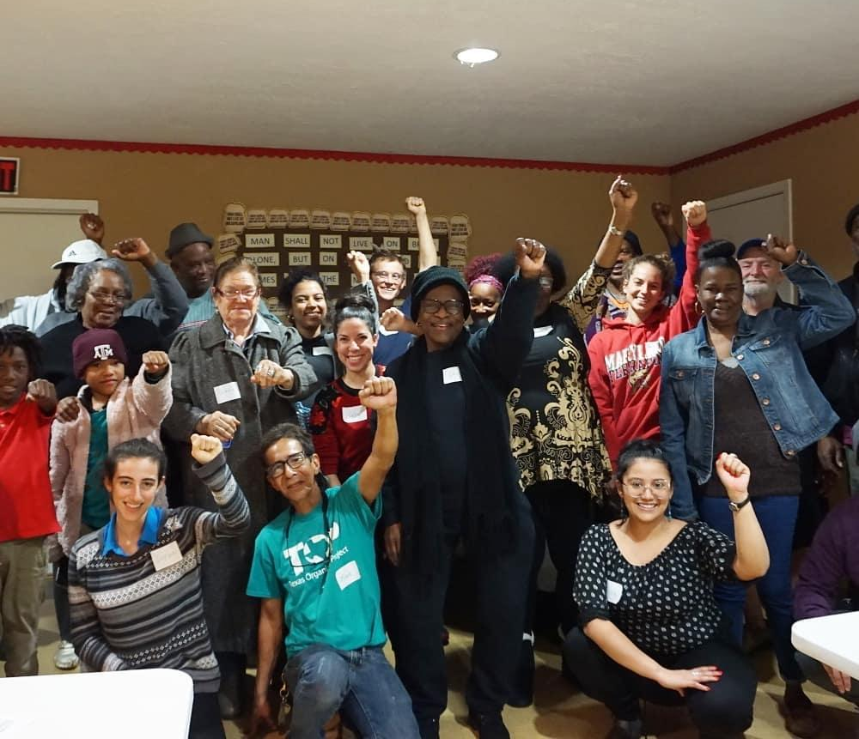
Organizing to Build Power

Slide 5
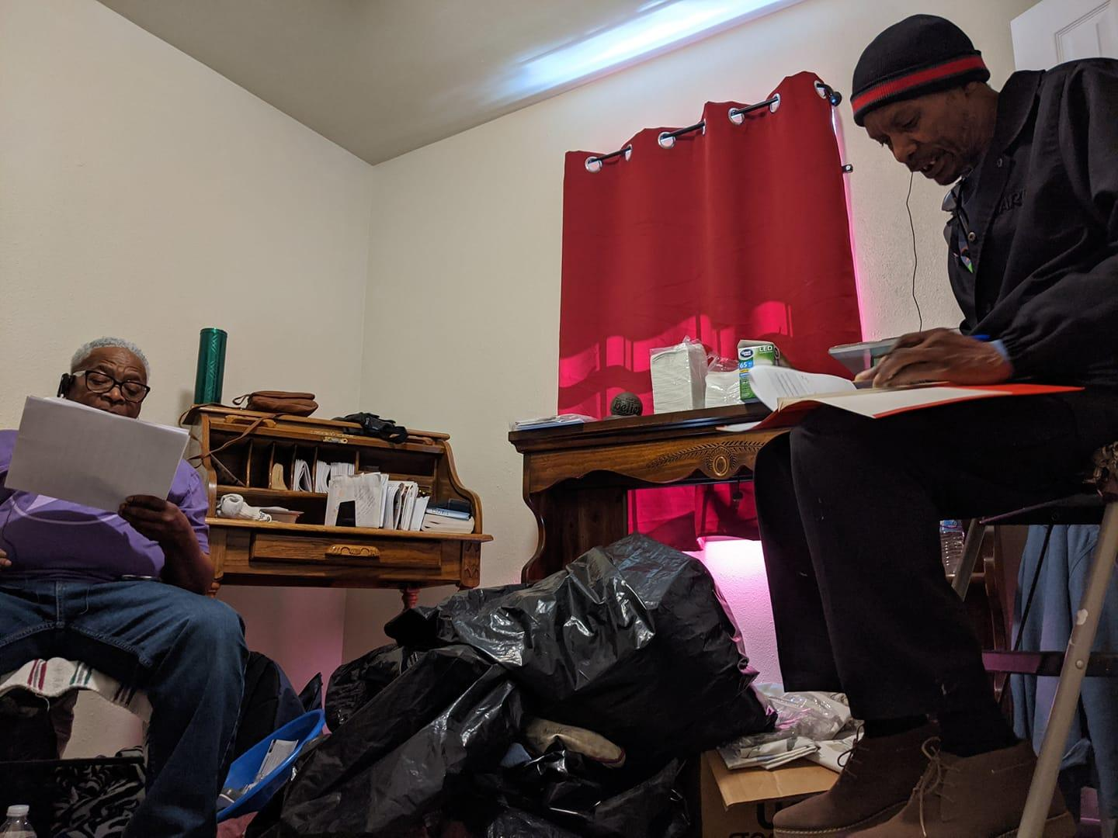
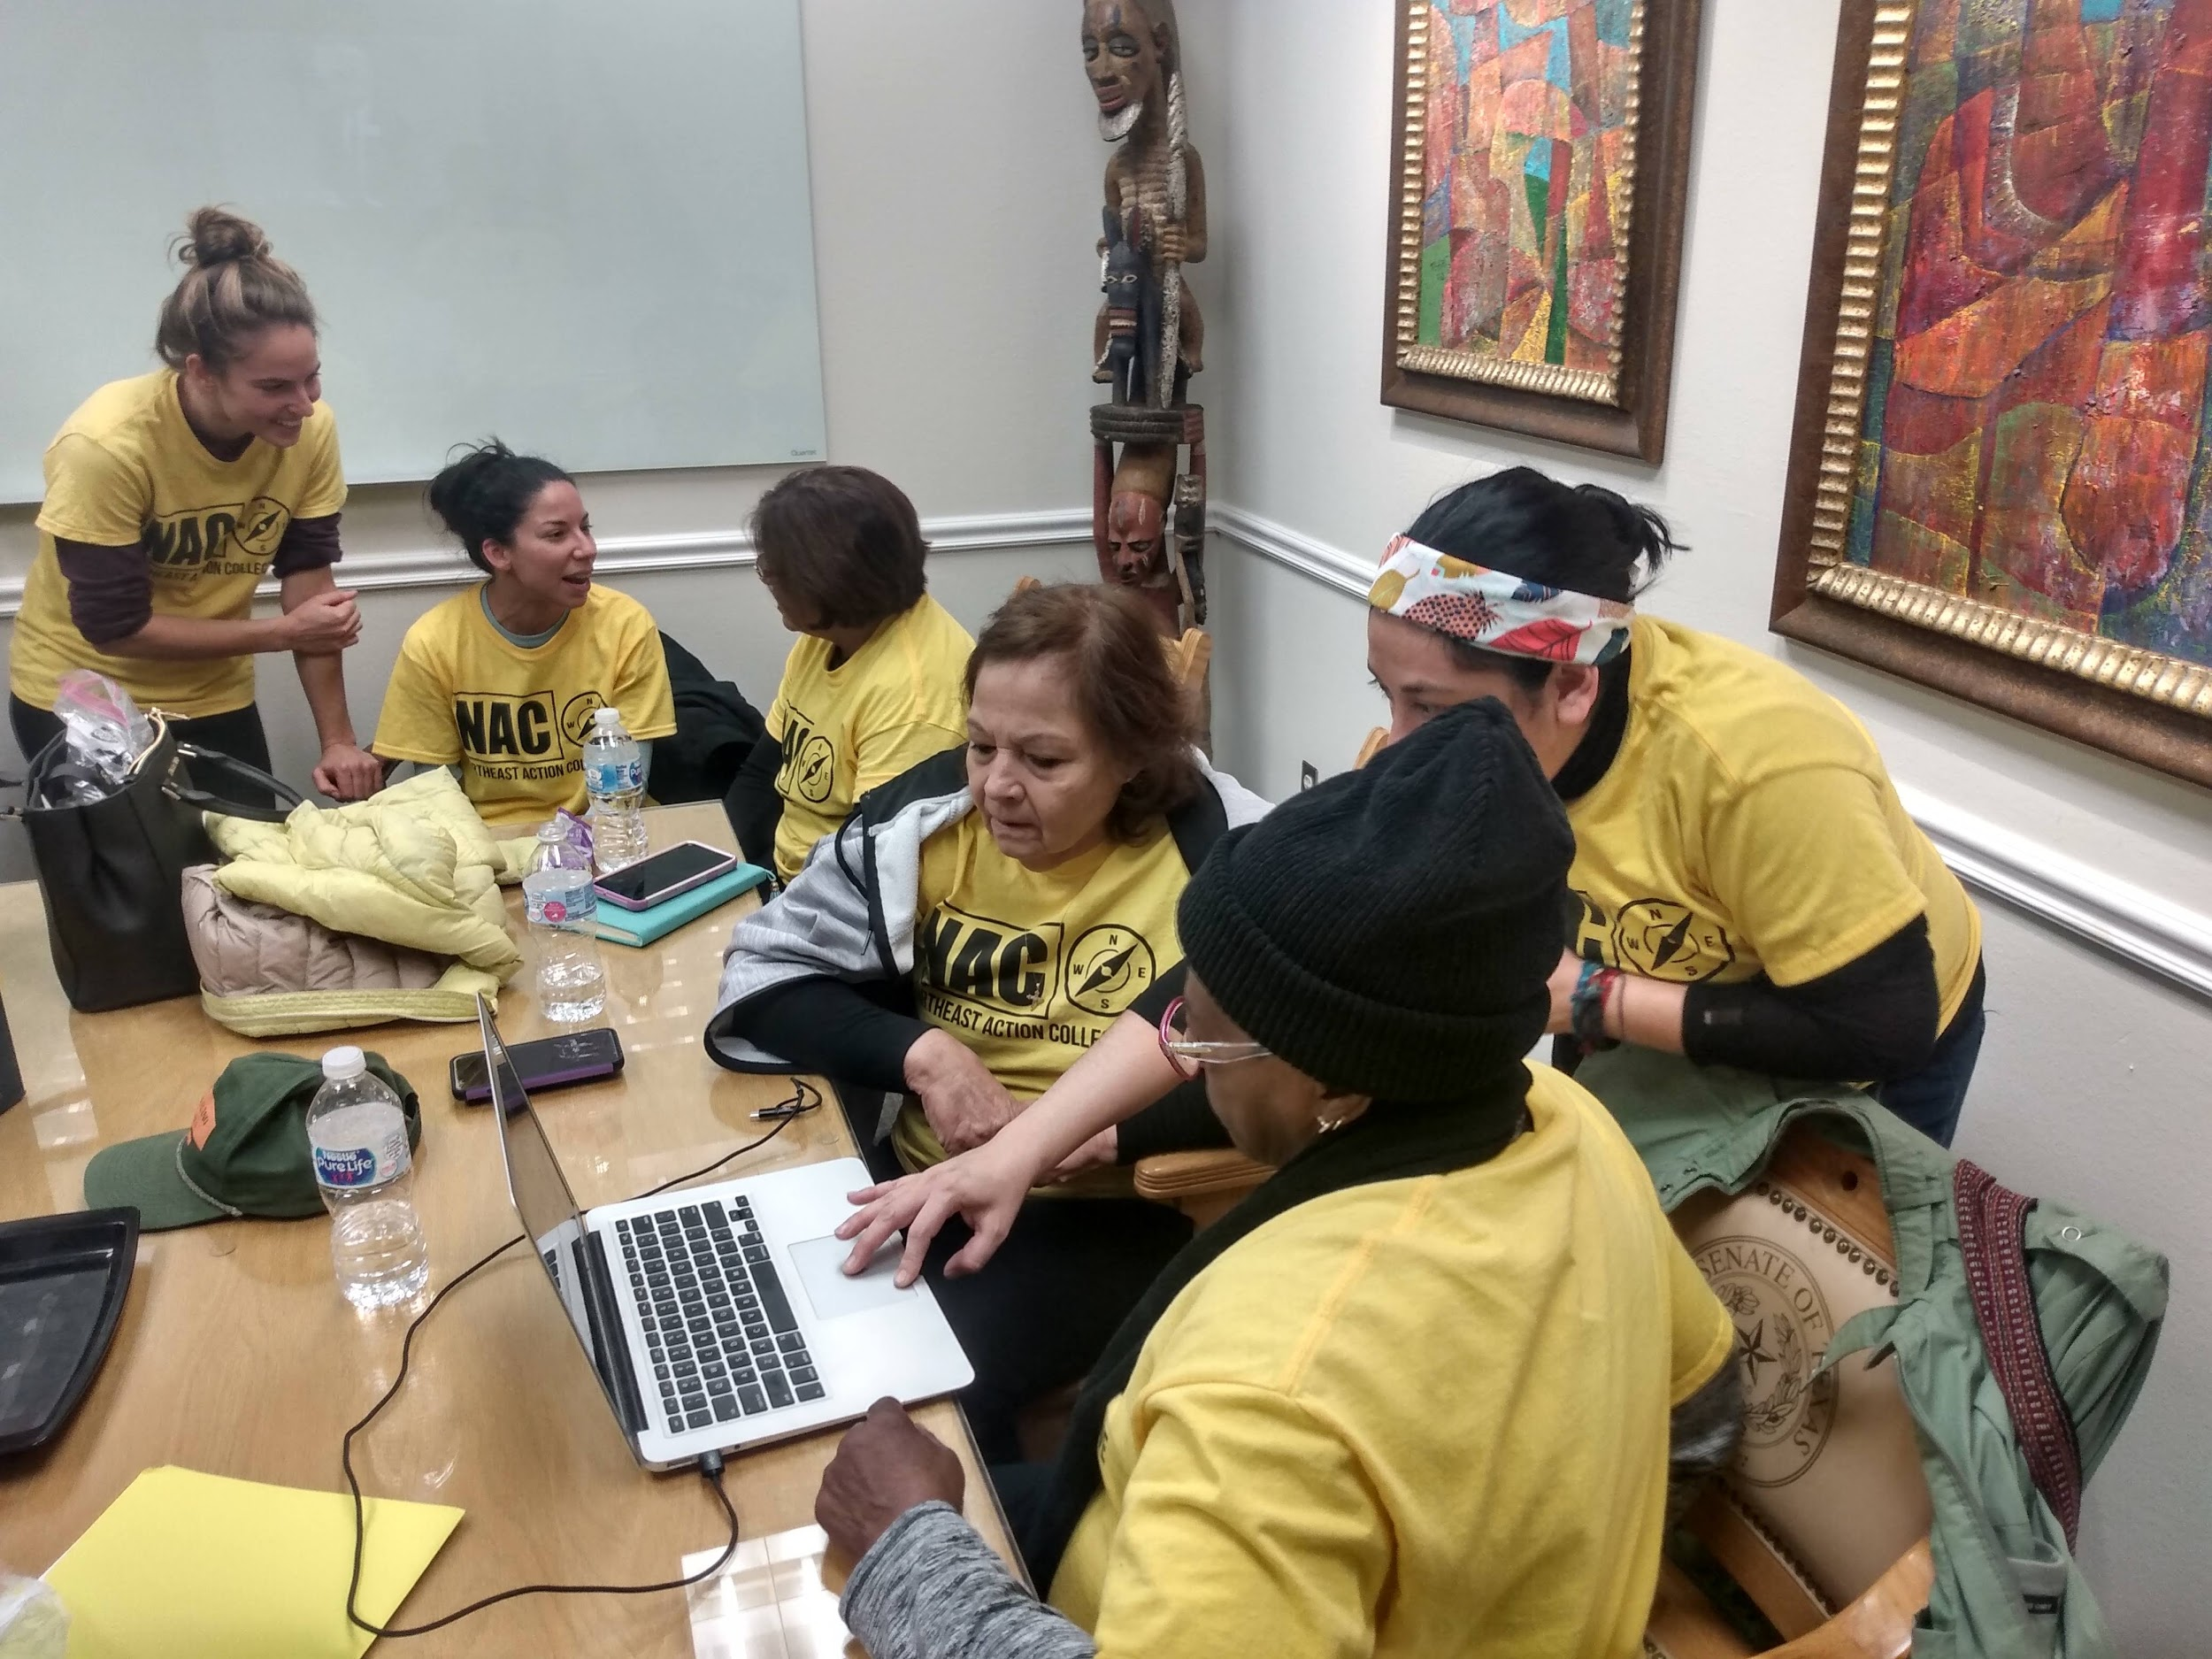
Building Communal Skills and Knowledge
Desarrollar habilidades y conocimientos comunitarios
Community Research that aims to inform Policy
Investigación impulsada por la comunidad para informar las políticas

Slide 6
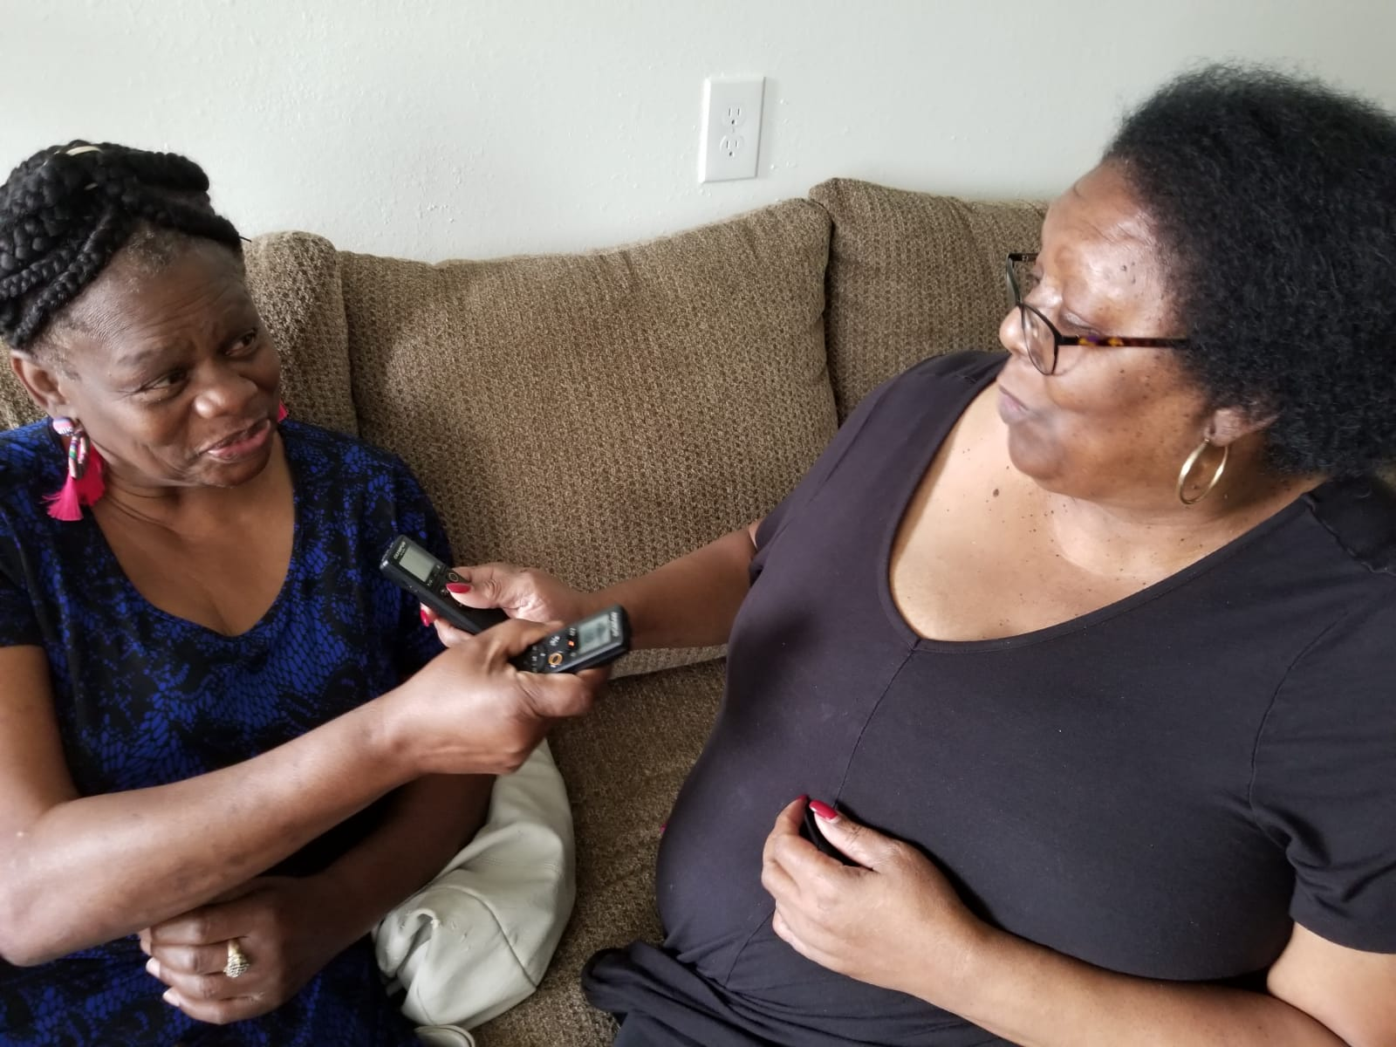
West Street Recovery is a “High Trust” organization:
Our fundamental belief is that people:
Are doing their best and want what is best for their communities
Know what they need to recover
Are honest and good.
But, community research is key to building trust in knowledge creation. And improving knowledge and understanding are key to making disaster recovery more effective.
Ms Anne Weston and Ms Barbara Herdon practice doing interviews for this project

Slide 7
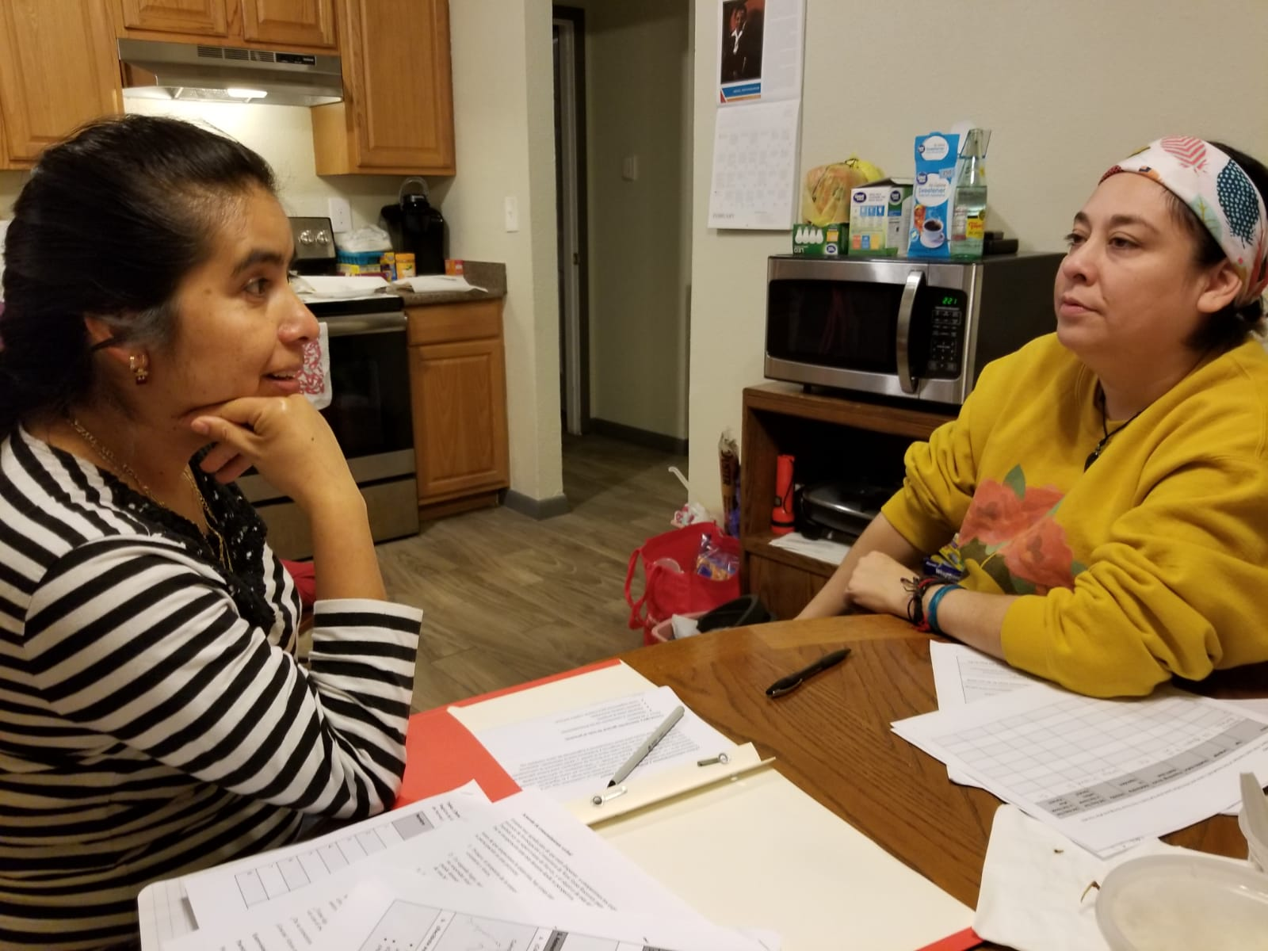
“Each disaster has its own recovery, but for some reason we never recover at the same rate as everyone else. There is no equity. “
Doris Brown, Community Researcher
The current approach to disaster recovery is not working.
(Results below gathered 3 years after Harvey.)

Slide 8
Recommendations: Applications and Eligibility
Be simplified & more accessible and oriented towards the goal of including as many people as possible.
Intake staff and program managers should understand the situations survivors are in by walking the streets and doing house visits
Eliminate the main causes of denial by changing eligibility guidelines
People with homes in heirship or with property debt should be made eligible for aid.
Aid must be given to people in the 100 year flood plain
People should not be denied for deferred maintenance

Slide 9
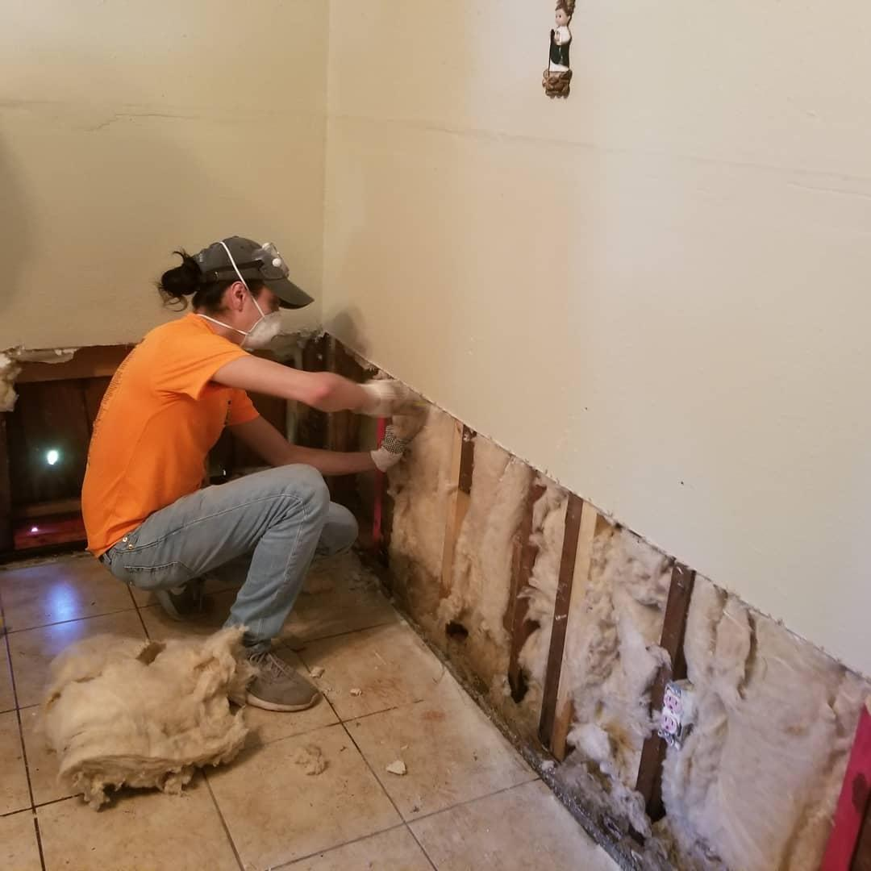
Recommendations: Home Repair
Make mucking and mold remediation services available quickly and coordinate with case management services including home repair intake.
Home repair Programs should:
Always be coordinated with temporary housing
Always strive for a one-stage rebuild process rather than partial rebuilds.
Do partial repairs when they limit further damage or improve health
Address issues predating the disaster

Slide 10
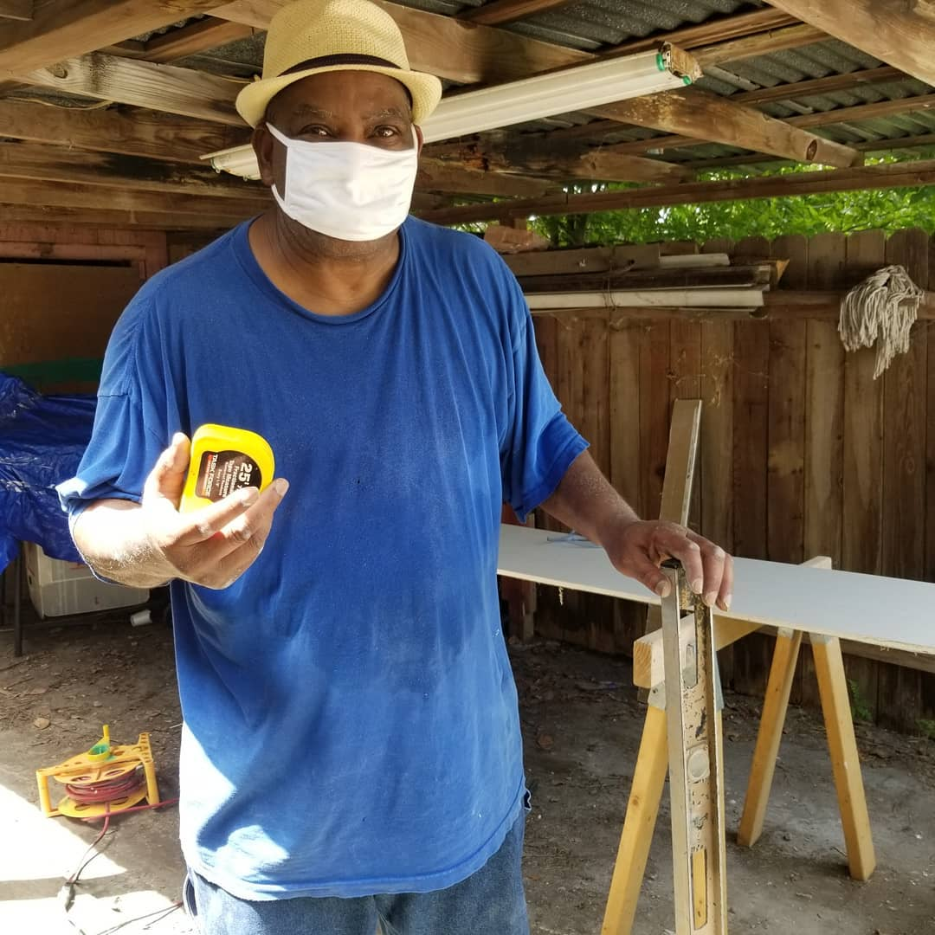
Recommendations: Home repair
Responsible parties must establish and maintain home repair programs before disasters.
Allow homeowners agency in the decision-making process.
Support the local economy: hiring from the neighborhood, buying from small, local businesses.
Make people who do self help eligible for reimbursement from HUD programs for their labor.

Slide 11
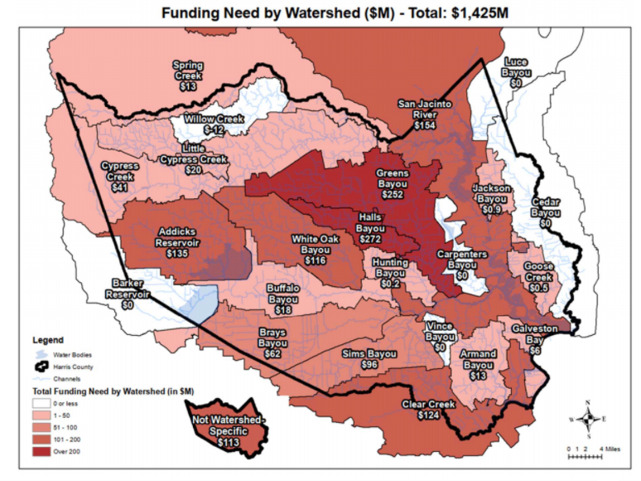
Structural Barriers to Recovery:
Class, Race, and Geography
Deliver more aid to poor and low income people & and do so more quickly
The entire disaster recovery apparatus must adopt an affirmative Anti-Racism and anti-poverty framework
Poor people and neighborhoods should be treated and seen to be worthy of the same services middle and upper class neighborhoods
Disaster recovery should be part of improving quality of life, home, and environment in low-income neighborhoods and eliminating ‘sacrifice zones’
Build trust and disaster systems through more regular and open communication and support between governments and residents in non disaster times
Recovery must address pre-existing issues from historic disinvestment at the household and neighborhood level
The map shows the funding gap for flood mitigation projects in Houston. As always BIPOC and poor areas have the greatest need.

Slide 12
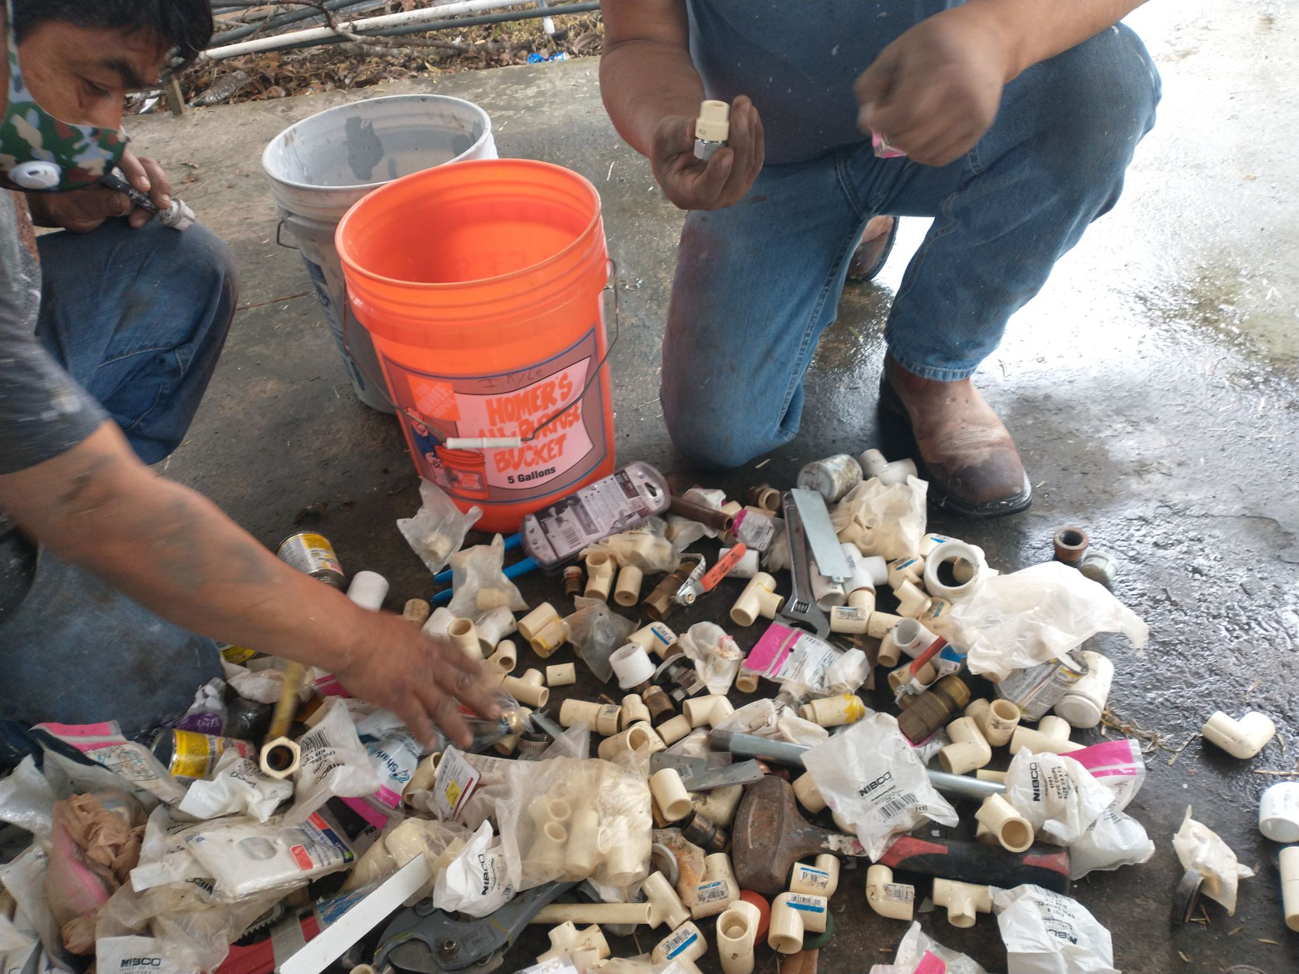
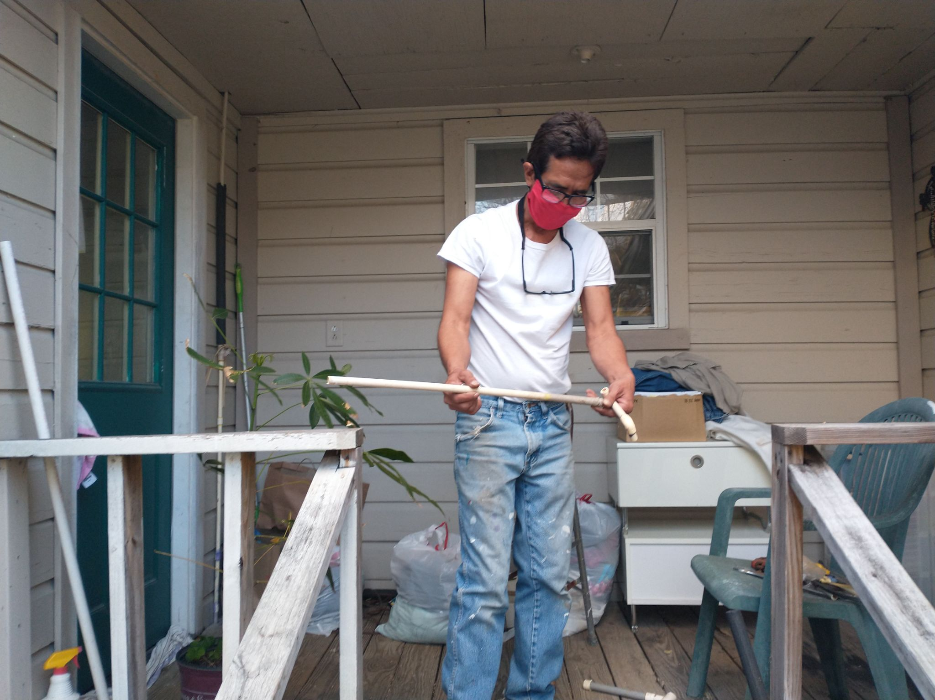
Intake staff should live in or have a long running connection to the neighborhood in which they work in order to better understand applicant needs and experiences and they should be empowered to reduce racial biases and lack of accountability in mass denials.
A just recovery requires flood prevention
Improve and maintain street drains & ditches
Improve and maintain bayous and flood water retention systems
Stop development that worsens flooding and contributes to climate change
Neighborhood Based Solutions

Slide 13
Barrier Analysis:
What are the barriers households and individuals face when trying to overcome disaster?
What steps can YOUR ORG make to remove and overcome barriers to recovery?
What connections/relationships does YOUR ORG need to strengthen to remove and overcome barriers to recovery?

Slide 14
“The ultimate, hidden truth of the world is that it is something that we make, and could just as easily make differently.”
― David Graeber, The Utopia of Rules: On Technology, Stupidity, and the Secret Joys of Bureaucracy

Slide 15
We will now take questions posted in the chat
Thank you

