Slide 1

Amplifying the 4 C's During Times of Food Insecurity
Fran Castellow, MSEd
President of Operations
Patient Advocate Foundation
Tom Shields
Manager, Client Experience
Team Rubicon
Notes:
Hi, I am Fran Castellow, President of Operations of Patient Advocate Foundation. PAF is a charitable patient services organization that helps patients with chronic and life threatending conditions overcome healthcare access and affordability challenges. Founded 25 years ago, we have provided direct help to more than 1.2 million people, ensuring their access to needed healthcare and helping find solutions to cost of living challenges faced by many. I have been with PAF for over 20 years and have the priviledge of overseeing the design and execution of all of our patient support programs, as well as the development of partnerhips that help us extend our reach to patients who need help. I am excited to share with you today the profile of the novel partnership between PAF and Team Rubicon, a shining example of non-profit partners leveraging complementary skills to quickly and efficiently step in and address gaps in support for patients in their greatest time of need.
And I am Tom Shields. Manger of client experience and capabilities at TR.
I’ve been with Team Rubicon for about 2 years now and have had the pleasure of engaging with, interacting and assisting many of our disaster clients throughout the country
TR is a non-profit, for-impact organization focused on delivering much needed programs and services to individuals, families and communities affected by disaster and humanitarian crises.
Since the devastating earthquake that struck Haiti in 2010, TR has been expanding its reach and purpose to target those most affected
By pairing the skills and experiences of military veterans with first responders, medical professionals, and technology solutions, Team Rubicon aims to provide the greatest service and impact possible.

Slide 2
Introduction
The global pandemic presented multiple obstacles which forced organizations to think outside the box
Team Rubicon (TR) and The Patient Advocate Foundation (PAF) were met with a unique opportunity to leverage the specific skillsets of their respective organizations with the financial support of the Bristol Myers Squibb Foundation to meet client needs
This presentation is an example of how 2 for-impact organizations applied the 4 C’s of Disaster Partnering and leveraged complimentary skills to develop an emergency food assistance program supporting immunocompromised patient
Notes:
Major tapped resource for this discussion is:
The Four Cs of disaster partnering: communication, cooperation, coordination and collaboration
Eric Martin, Isabelle Nolte, Emma Vitolo (2016)
© 2016 The Author(s). Disasters © Overseas Development Institute, 2016
This allows for a better understanding of each of the 4 C’s and how they apply
Reference will be shared at the end of the session
Main goal is last bullet

Slide 3
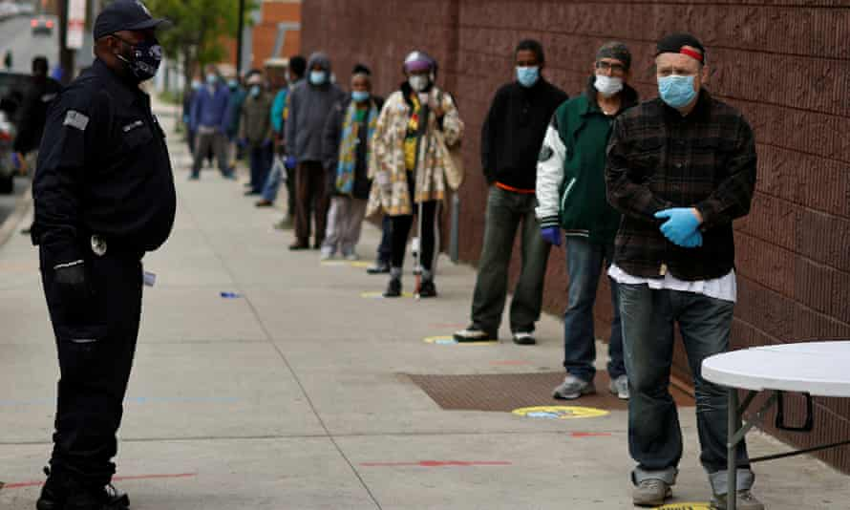

Implications of COVID-19 for perspective…
2019
Food insecurity was 35.2 million or 1 in 9 people (20yr low)
Unemployment rate dropped as low as 3.5% (lowest reported since 1969)
2020
Food insecurity increased to 45 million or 1 in 7 people
Unemployment rose to 14.7% (reflecting the largest monthly increase and the highest rate since 1948)
Notes:
Fran
Food insecurity has been long term problem in our communities with 15 million households not having enough food on a regular basis before COVID-19 struck. 2019 data reveals that 35.2 million people were food insecure. That means 1 in 9 people were uncertain, at times, where their next meal would come from. Surprisingly, this represents a 20 year low in people experiencing food insecurity. Still a staggeringly tragic number in a the most civilized country in the world, signs of improvement by all accounts. These improvements were likely liked to the improved unemployment rate in 2019 with only 3.5% of the able bodied workforce being out of work, the lowest unemployment rate in 50 years. While there was still much work to do to help millions of americans experiencing food insecurity, incremental progress was being made.
Fast forward to dearly 2020. As the pandemic swept across the US, and the world, it proved to be a personal disaster in the lives to people who were living independently, though reliant on their next paycheck to remain financially sound. The impact of business closures, social distancing and mandatory stay at home orders crated greater need and additional hardships for many. Sadly, the gains that had been made in solving the unsolvable food insecurity puzzle, and improving the employment status of many, were wiped away in a matter of months. Unemployment skyrocketed to 14.7%, the highest rate since 1948, and worse, the number of people experiencing food insecurity swelled to a staggering 45 million Americans, or one in seven people being uncertain on a daily basis if their basic food needs would be met. Food banks struggled to find ways to fee Americans who were out of work and other government programs were unable to keep up with the demand for help.

Slide 4
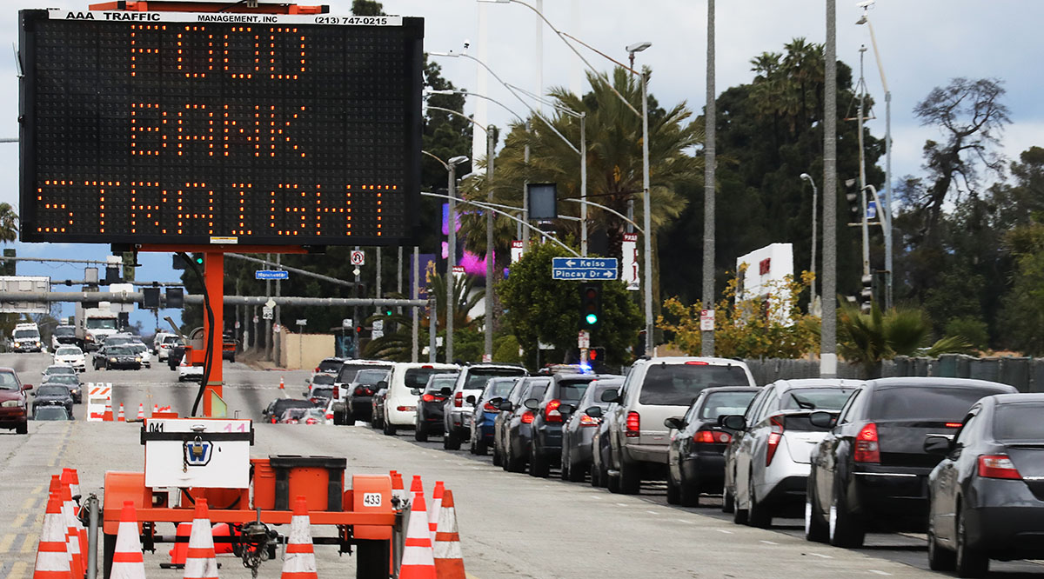


Immunocompromised Patients:
Pre-Pandemic
When asked about the level of their financial stress:
78% experienced ‘high’ or ‘overwhelming’ levels
More than75% of patients with cancer, RA and MS reported an annual income <$48,000
Notes:
Fran
The global COVID-19 pandemic has brought many unforeseen challenges and has, and continues to, take an incredible toll on many. Many people have experienced job los due to COVID-19 restrictions which exacerbates financial distress for many who were already struggling, particularly low income, minority and immunocomproised individuals.
Even before the pandemic, people living with chronic and critical diseases such as Cancer, RA and MS often struggled to balance the ongoing impact of their illness on their ability to work, finances and physical wellbein. PAF’s data reveals that more than 75% of people we served living with these conditions had a household income of $48,000 or less with nearly 50% having incomes of less than $23,000. 99% of those with cancer reported experiencing some level of financial stress, with 78% of them reporting that stress to be high or overwhelming. All of these patients were reaching out to PAF asking for support with medial bills and cost of living expenses as they were just barely making it.

Slide 5
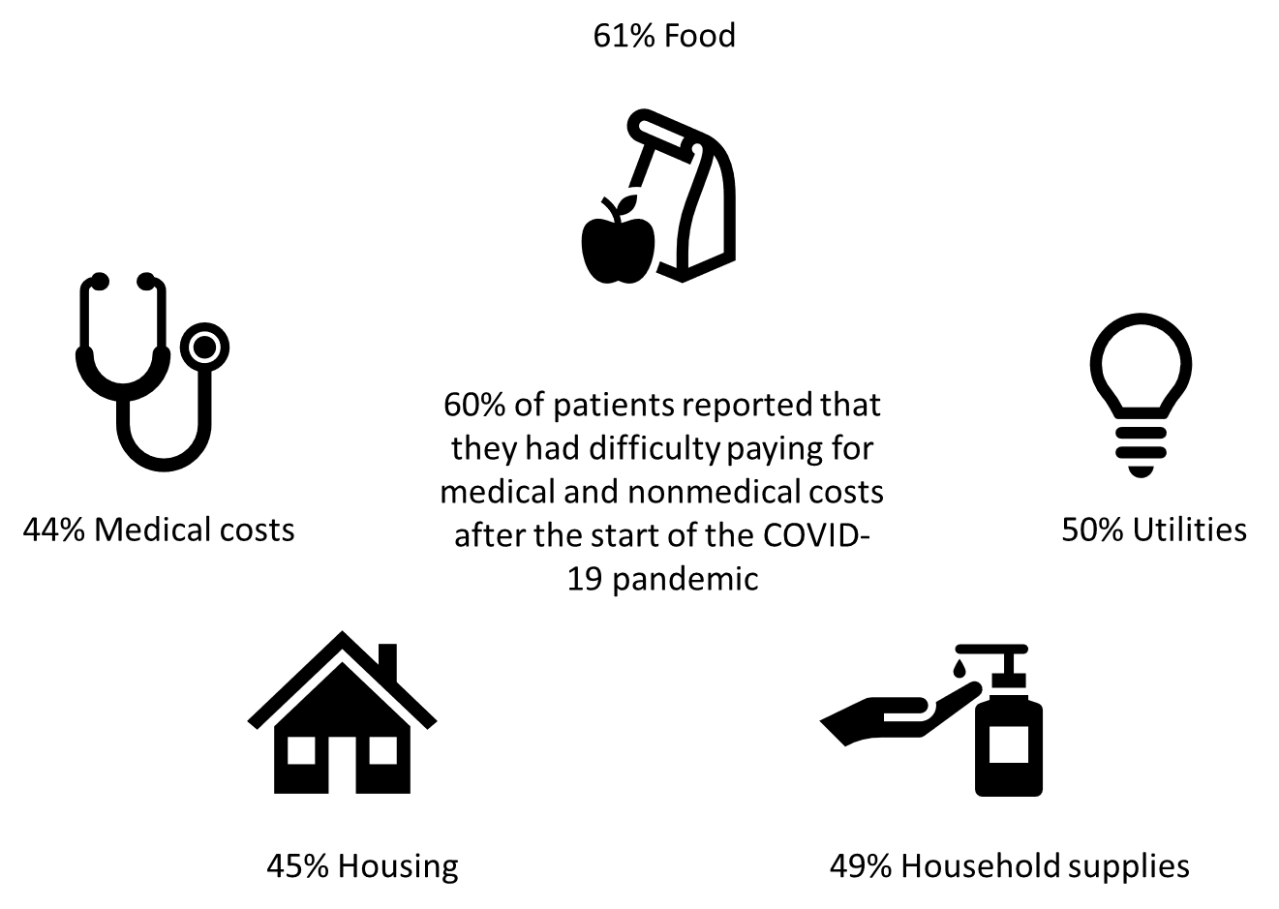
Immunocompromised Patients: Post-Pandemic
Notes:
When the pandemic hit, it simply proved to be more than many patients living with chronic and critical diseases could bear. PAF’s Pandemic Impact Survey revealed that 60% of patients were having difficulty paying for medical and non-medical costs after the start of the pandemic, with 61% reporting food as their greatest need. Job loss, loss of income and insurance and the very real threat to their already compromised health resulted in a staggering rise in requests for help to PAF and other voluntary health agencies. People went without basic necessities and needed medical care. Something had to be done to address the very personal disaster people living with these chronic conditions were facing.
Bristol Myers Squibb Foundation is an organization that promotes health equity and seeks to improve the health outcomes of populations disproportionally affected by serious diseases. The Foundation does this by strengthening healthcare worker capacity, integrating medical care and community-based supportive services, and mobilizing communities in the fight against disease. BMSF identified the fact that people living with Cancer, Rheumatoid Arthritis and Multiple Sclerosis, and therefore severely immunocompromised were severely impacted the health risks posed by COVID-19, so much so that they that they could often not leave their homes safely for essentials such as food and basic essentials, medical care or to continue to work in environments that were heavily populated.
BMSF charted a course to bring some much needed help to immunocompromised patients. BMSF convened a focus group of non-profit advocacy organizaitons who collectively raised the concern of food access for immunocompromised people living with cancer, RA and MS as their ability to safely work or go out to get basic ncecessities was complicated further by COVID-19. Fueled by these insights, BMSF sought out and brought together two PAF and TR, who, with the support of BMSF, created a novel collaboration with the aim of providing assistance to this vulnerable population. We collectively felt that fighting hunger should be one less battle that Americans, specifically those with major health conditions, should be asked to face as we moved forward on the path through, and out of, the pandemic.

Slide 6





BMSF promotes health equity and seeks to improve the health outcomes of populations disproportionally affected by serious diseases.
PAF traditionally supports individuals and families experiencing a personal health crisis or personal disasters
TR traditionally supports individuals and families affected by a widespread disaster
Notes:
What is the broad objective of each of these organizations
Make the case for why they partnered

Slide 7
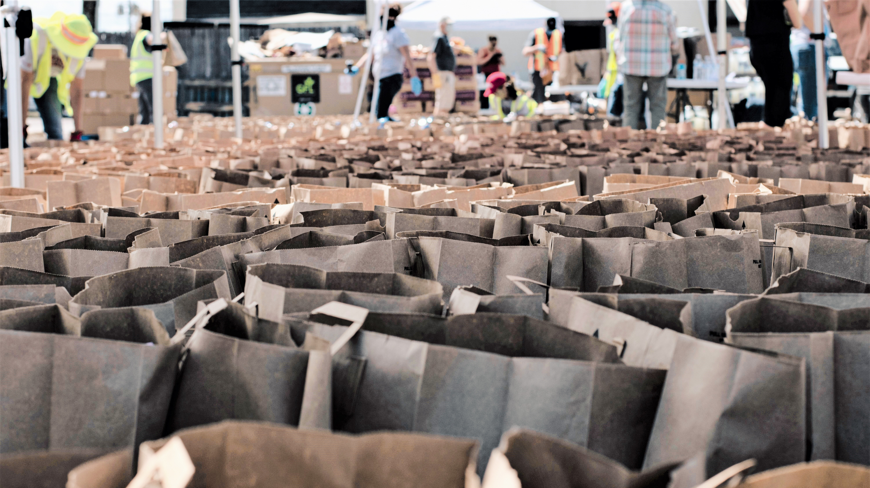
THE 4 C’S
OF DISASTER
PARTNERING
COMMUNICATION
COORDINATION
COLLABORATION
COOPERATION
Notes:
Partnering in disasters come with 4 key variables which are: Communication, Coordination, Collaboration, & Cooperation AKA the 4 C’s of disaster partnering
We will touch on each variable and provide some specific examples that we were faced with and follow up with some lessons learned

Slide 8




Communication
Contributing factors to effective communication
  COVID Environment
  Scale of operation
  Audience (Patient makeup and vulnerabilities)
  Interorganizational communication processes
Notes:
Communication: Critical for collective action and understanding. Arguably the first step.
Contributing factors to effective communication
COVID Environment-This new normal forced almost 100% of communications to be virtual
With the exceptions of volunteer delivery of groceries (which was still “no contact”), all communications with patients were via telephone, SMS messaging, and email
Scale of operation
This was a nationwide operations and as such special considerations needed to be addressed
Language services
Understanding of rural vs urban needs and capabilities
Audience (Patient makeup and vulnerabilities)
Most patients shared unique characteristics including elderly, low income, immunocompromised, & not technologically literate
Providing traditional communication conduits is as important as Leveraging new technologies
Interorganizational communication processes
Leveraged shared technology platforms (Microsoft Teams)

Slide 9
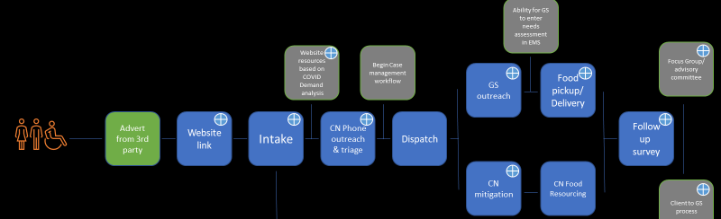

Cooperation
Understanding each organization’s responsibilities and leveraging skillsets
TR’s existing veteran-volunteer force of 120,000 nationwide
Robust Enterprise Management System
in-depth Case Management support
Experienced financial grant disbursement program
Funding specialty programs to bridge cancer care as well as aid to vulnerable populations
Notes:
To Operate together in the same space for the same end results
“As you can see in the EFA Client Journey Map, Each touchpoint is color codes and aligns with the responsibilities of either TR, PAF, or the volunteer workforce”
“Another important contributing factor to success of cooperation is to determine and set a cadence for the frequency of interaction. This will ensure adequate information sharing and accountability is adhered to”
“Co-Operate” in the space

Slide 10





Coordination
Coordination begins with the adoption or creation of a plan that all members understand and agree upon
Breaking complex problems into manageable pieces
WEBSITE DEVELOPMENT
APPLICANT SCREENING
GROCERY PICKUP AND DELIVERY
GRANT APPLICATION
GRANT APPLICANT SCREENING
FINANCIAL DISBURSEMENT
Notes:
Since we’ve identified the skill of TR, the patient advocate foundation, and BMDF we are now able to action those skills…. And more importantly align those action
Which brings us to the 3rd c of disaster partnering ……………Coordination……..Simply put, Coordination is aligning actions. But before we could do that, we needed to create a plan that all member understood and agreed to. Once completed, we were able to break down complex problems within the plan into manageable pieces …………………We knew this build had a lot of moving parts and we needed to identify who would be responsible for those parts. By breaking them down and identifying who was best suited for each, we were able to efficiently manage responsibilities. ………………The tasks listed here are just a few examples of where these responsibilities fell………………..Tasks such as Applicant Screening and Grocery pick up and delivery were a sole responsibility of TR much like the tasks of grant application screening and financial disbursement were isolated to PAF. However there were instances ---such as websites development, and grant application development where TR and PAF worked together and shared responsibility which is a testament to why Communication is arguable the most important C in the Process.

Slide 11

Collaboration
Organizations collectively begin to take ownership of the risks associated with a partnership
Bringing Communication, Cooperation, and Coordination together
Most complex of the 4 C’s
Notes:
Ok So now that we have begun operating in the space together for the same end-result
Only as successful as transparency of organizations involved
However, one caveat to effective collaboration, is a willingness to share information and suppress organizations egos – be open and honest for the mission’s sake

Slide 12
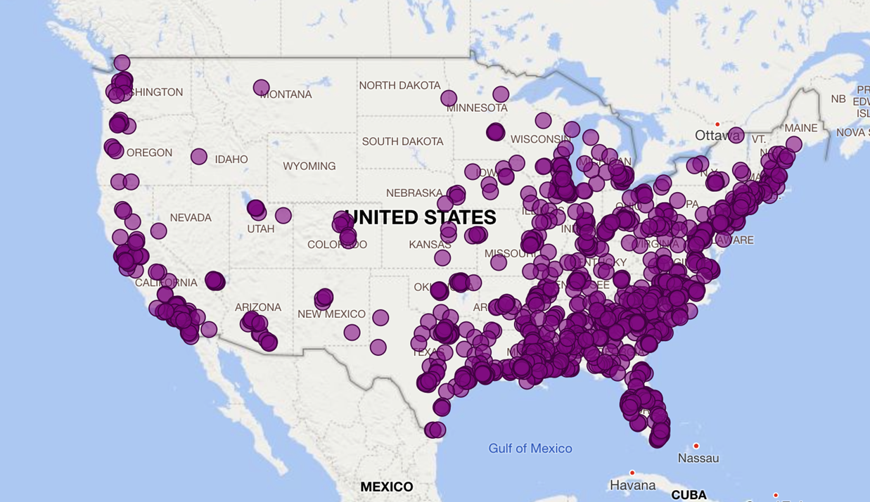
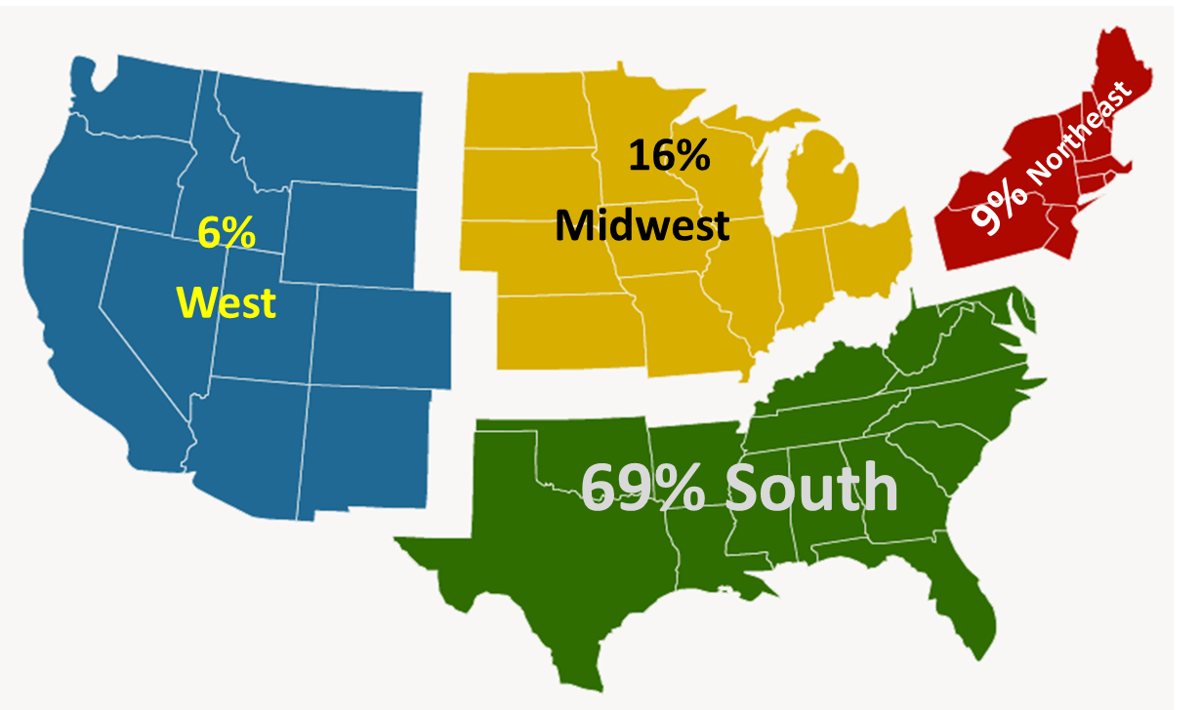
Program Outcomes/Evolution
Delivered grocery and food assistance to 2,711
Case Management support to over 1500 patients
Financial support to 23,184 patients ($500 Check)
Dedicated a PAF Case Manager to the program August-early October after the fund closed to provide ongoing support to patients
PAF and TR continue to discuss future strategic collaborations that can meet the practical needs of patients living through personal or community disasters.
Notes:
The program ultimately served well over 25,000 patients from May-September 2020.
This included providing logistical support in the form of grocery and food delivery to 2711 patient’ homes. Data collected by TR from patients that received food pick up and delivery services, demonstrated that 82&% of patients were satisfied or extremely satisfied with the assistance they received and three quarters of the patients would recommend these services to others.
The program also provided grants ranging from $300-$500 to 23,185 patients. Our data found that 66% of the 23,000 grant recipients were African American and 75% were disabled, unemployed or retired. Further, 97% of Grant recipients reported the impact of the financial assistance they received to purchase food as an 8 or higher on a scale of 1-10 with nearly 86% of patients rating the impact of the grant funding as a 10.
Beyond the logistical and financial support provided to patients by PAF and TR, both organizations collaborated to go the extra mile and provide in depth case management support to over 1500 patients,who had needs beyond food insecurity. These needs included access to care and medications, financial concerns relative to cost of living expenses and job loss that threatened their insurance coverage. We connected them to additional local and national assistance programs, evaluating their eligibility for disability, unemployment and insurance coverage and educated them on the provisions available under the multiple government stimulus packages that were passed in 2020. This work was not in the original program design, however, it became evident that some people were struggling and needed more support over a longer period of time. PAF and TR pivoted and expanded its program operations to meet those needs.

Slide 13
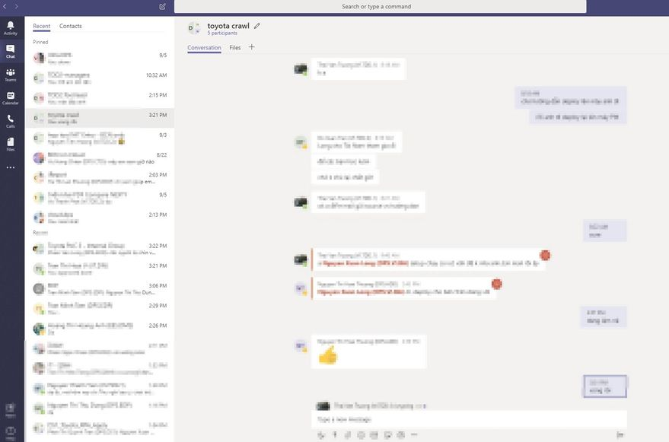
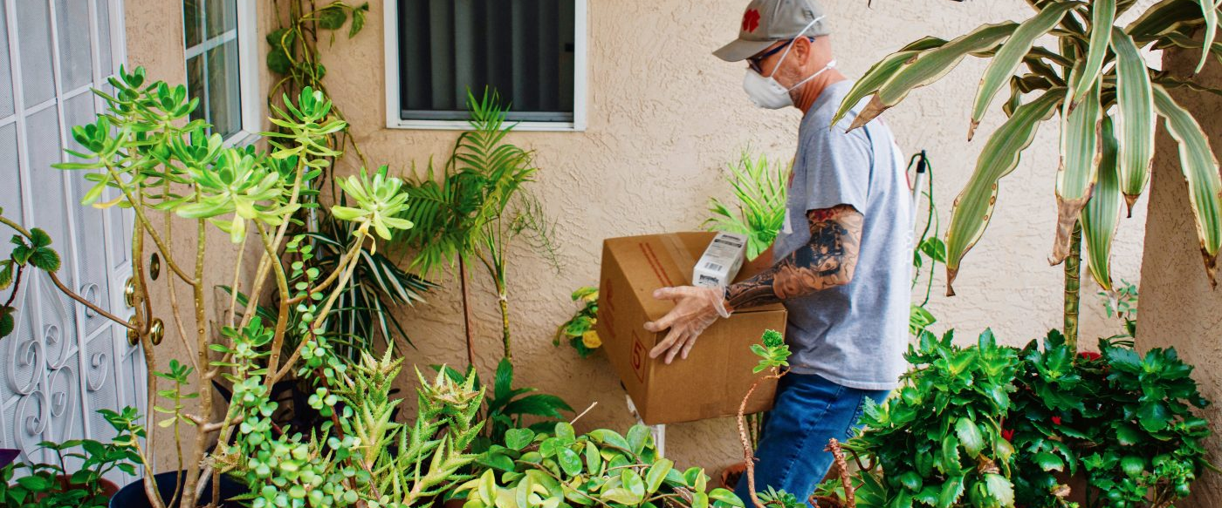
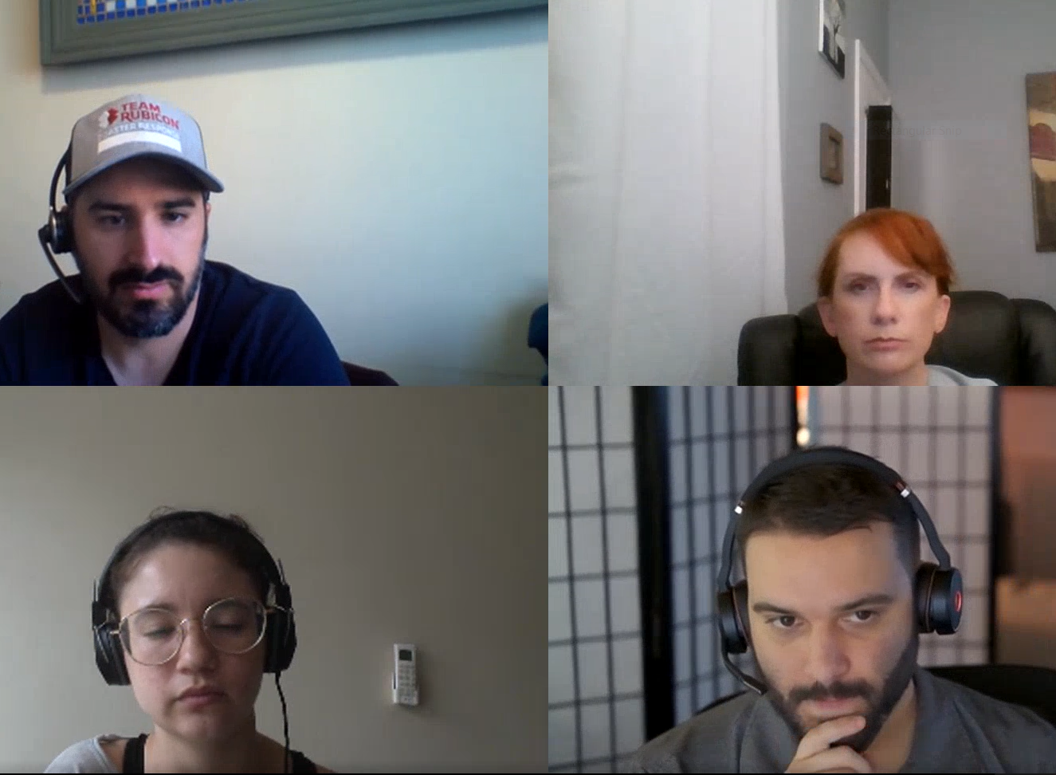
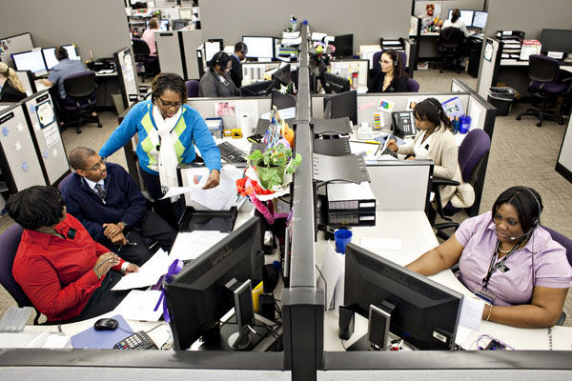
Lessons Learned
Photo taken prior to pandemic.
Notes:
The 4 C’s of disaster partnering also applies to the disaster client
1. Communication: Meet the client where they are with communication (i.e., phone, sms, email, etc…)
2. Cooperation: focusing on client instructional as much as volunteer instructional (More FAQ’s )
3. Coordination: Allow the client to suggest solution or preference to complex problems
4. Collaboration: Invite the client to be an advisor to future operations (Quick survey and follow up)
Key Lessons learned
• “Time” was a big factor- disasters don’t afford much response time so planning in advance is ideal (though not always possible)
Call center needs- need to be sure to have people who can talk to patients, not just rely on technology as the connection point
• Surrender egos and create transparency
Credit does not matter; fulfilling the mission is all that matters and doing whatever it takes to get the job done is necessary
• Earlier cooperation with all members of the team
• Omni-channel presence
Meeting clients where they are (i.e., SMS vs email or web vs mobile)

Slide 14


Slide 15
THANK YOU!
Special thanks to the Bristol Myers Squibb Foundation. Their financial support of over 11 million dollars allowed TR & PAF to assists these patients
Notes:
The Bristol Myers Squibb Foundation (BMSF) promotes health equity and seeks to improve the health outcomes of populations disproportionally affected by serious diseases. The Foundation does this by strengthening healthcare worker capacity, integrating medical care and community-based supportive services, and mobilizing communities in the fight against disease.

Slide 16
References
The Four Cs of disaster partnering: communication, cooperation, coordination and collaboration.
Martin, E., Nolte, I. and Vitolo, E. (2016), Disasters, 40: 621-643.
https://doi.org/10.1111/disa.12173
Food Insecurity in the U.S. By The Numbers
Silva
https://www.npr.org/2020/09/27/912486921/food-insecurity-in-the-u-s-by-the-numbers
Job market remains tight in 2019, as the unemployment rate falls to its lowest level since 1969 : Monthly Labor Review
https://www.bls.gov/opub/mlr/2020/article/job-market-remains-tight-in-2019-as-the-unemployment-rate-falls-to-its-lowest-level-since-1969.htm#:~:text=The%20national%20unemployment%20rate%20declined,when%20it%20was%203.4%20percent.
The Impact of Coronavirus on Food Insecurity
https://www.feedingamerica.org/research/coronavirus-hunger-research
Bureau of Labor Statistics, U.S. Department of Labor, The Economics Daily, Unemployment rate falls to 6.9 percent in October 2020
https://www.bls.gov/opub/ted/2020/unemployment-rate-falls-to-6-point-9-percent-in-october-2020.htm

Slide 17


TR’s existing veteran-volunteer force of 120,000 nationwide
Robust Enterprise Management System
in-depth Case Management support
Experienced financial grant disbursement program
Funding specialty programs to bridge cancer care as well as aid to vulnerable populations
Notes:
TR and PAF had not relation before COVID-19. This was two organizations that wanted to leverage the unique strength of each other to solve a problem.
Preferably before the disaster occurs but often during or after

